Slide 1
A New Approach to Air Force Career Field Assignment
D. Griffen Laird, Second Lieutenant, USAF
16 Feb 2022

Slide 2
Overview
Background
Problem Description
Modeling Techniques
Original Methodology
New Approach
Solution Methods
Model Comparison
Example Instance Analysis
Conclusions

Slide 3
Overview
Background
Problem Description
Modeling Techniques
Original Methodology
New Approach
Solution Methods
Model Comparison
Example Instance Analysis
Conclusions

Slide 4
Overview
Background
Problem Description
Modeling Techniques
Original Methodology
New Approach
Solution Methods
Model Comparison
Example Instance Analysis
Conclusions

Slide 5
Overview
Background
Problem Description
Modeling Techniques
Original Methodology
New Approach
Solution Methods
Model Comparison
Example Instance Analysis
Conclusions

Slide 6
Overview
Background
Problem Description
Modeling Techniques
Original Methodology
New Approach
Solution Methods
Model Comparison
Example Instance Analysis
Conclusions

Slide 7
Overview
Background
Problem Description
Modeling Techniques
Original Methodology
New Approach
Solution Methods
Model Comparison
Example Instance Analysis
Conclusions

Slide 8
Overview
Background
Problem Description
Modeling Techniques
Original Methodology
New Approach
Solution Methods
Model Comparison
Example Instance Analysis
Conclusions

Slide 9
Overview
Background
Problem Description
Modeling Techniques
Original Methodology
New Approach
Solution Methods
Model Comparison
Example Instance Analysis
Conclusions

Slide 10
Background
“What distinguishes our military, what makes us the premier fighting force in the world and guarantees it will prevail in any conflict, is the quality of our service members” Secretary of Defense Mark T. Esper

Slide 11

Background
Each year, the Air Force Personnel Center (AFPC) assigns cadets to their career fields, denoted by Air Force Specialty Codes (AFSCs)
AFSCs secure the future lieutenants’ careers in the Air Force
Alternative solution assignments must meet certain objective criteria

Slide 12
Background
Each year, the Air Force Personnel Center (AFPC) assigns cadets to their career fields, denoted by Air Force Specialty Codes (AFSCs)
AFSCs secure the future lieutenants’ careers in the Air Force
Alternative solution assignments must meet certain objective criteria

Slide 13
Background
Each year, the Air Force Personnel Center (AFPC) assigns cadets to their career fields, denoted by Air Force Specialty Codes (AFSCs)
AFSCs secure the future lieutenants’ careers in the Air Force
Alternative solution assignments must meet certain objective criteria

Slide 14

Problem Description
Air Force defines “priorities” for the assignment solution
Priorities pertain to characteristics of the cadets assigned to the AFSCs

Slide 15
Problem Description
Air Force defines “priorities” for the assignment solution
Priorities pertain to characteristics of the cadets assigned to the AFSCs

Slide 16
Problem Description
AFSC Quotas
Each AFSC provides a range on the number of assigned cadets acceptable
Each AFSC may also specify a minimum number of cadets from each commissioning source
United States Air Force Academy (USAFA) cadets
Reserve Officer’s Training Corps (ROTC) cadets
Combined USAFA and ROTC targets (their sum) is the AFSC quota

Slide 17
Problem Description
AFSC Quotas
Each AFSC provides a range on the number of assigned cadets acceptable
Each AFSC may also specify a minimum number of cadets from each commissioning source
United States Air Force Academy (USAFA) cadets
Reserve Officer’s Training Corps (ROTC) cadets
Combined USAFA and ROTC targets (their sum) is the AFSC quota

Slide 18
Problem Description
AFSC Quotas
Each AFSC provides a range on the number of assigned cadets acceptable
Each AFSC may also specify a minimum number of cadets from each commissioning source
United States Air Force Academy (USAFA) cadets
Reserve Officer’s Training Corps (ROTC) cadets
Combined USAFA and ROTC targets (their sum) is the AFSC quota

Slide 19
Problem Description
AFSC Qualifications
Air Force Officer Classification Directory (AFOCD) outlines AFSC qualifications based on the cadets’ Classification of Instructional Programs (CIP) codes
Example AFOCD degree tier classification for the AFSC 35P, “Public Affairs”
Tier | Target | CIP | Program Description | Requirement
1 | ≥ 70% | 09.XXXX | Communication, Journalism and Related Programs | Mandatory
2 | ≥ 20% | 23.13XX | Rhetoric and Composition/Writing Studies | Desired
 |  | 42.XXXX | Psychology
 |  | 45.09XX | International Relations and National Security Studies
 |  | 45.10XX | Political Science and Government
 |  | 52.14XX | Marketing
3 | ≤ 10% | XX.XXXX | Any Degree | Permitted

Slide 20
Problem Description
AFSC Qualifications
Air Force Officer Classification Directory (AFOCD) outlines AFSC qualifications based on the cadets’ Classification of Instructional Programs (CIP) codes
Example AFOCD degree tier classification for the AFSC 35P, “Public Affairs”
Tier | Target | CIP | Program Description | Requirement
1 | ≥ 70% | 09.XXXX | Communication, Journalism and Related Programs | Mandatory
2 | ≥ 20% | 23.13XX | Rhetoric and Composition/Writing Studies | Desired
 |  | 42.XXXX | Psychology
 |  | 45.09XX | International Relations and National Security Studies
 |  | 45.10XX | Political Science and Government
 |  | 52.14XX | Marketing
3 | ≤ 10% | XX.XXXX | Any Degree | Permitted

Slide 21
Problem Description
AFSC Qualifications
Air Force Officer Classification Directory (AFOCD) outlines AFSC qualifications based on the cadets’ Classification of Instructional Programs (CIP) codes
Example AFOCD degree tier classification for the AFSC 35P, “Public Affairs”
Tier | Target | CIP | Program Description | Requirement
1 | ≥ 70% | 09.XXXX | Communication, Journalism and Related Programs | Mandatory
2 | ≥ 20% | 23.13XX | Rhetoric and Composition/Writing Studies | Desired
 |  | 42.XXXX | Psychology
 |  | 45.09XX | International Relations and National Security Studies
 |  | 45.10XX | Political Science and Government
 |  | 52.14XX | Marketing
3 | ≤ 10% | XX.XXXX | Any Degree | Permitted

Slide 22
Problem Description
AFSC Qualifications
Air Force Officer Classification Directory (AFOCD) outlines AFSC qualifications based on the cadets’ Classification of Instructional Programs (CIP) codes
Example AFOCD degree tier classification for the AFSC 35P, “Public Affairs”
Tier | Target | CIP | Program Description | Requirement
1 | ≥ 70% | 09.XXXX | Communication, Journalism and Related Programs | Mandatory
2 | ≥ 20% | 23.13XX | Rhetoric and Composition/Writing Studies | Desired
 |  | 42.XXXX | Psychology
 |  | 45.09XX | International Relations and National Security Studies
 |  | 45.10XX | Political Science and Government
 |  | 52.14XX | Marketing
3 | ≤ 10% | XX.XXXX | Any Degree | Permitted

Slide 23
Problem Description
AFSC Qualifications
Air Force Officer Classification Directory (AFOCD) outlines AFSC qualifications based on the cadets’ Classification of Instructional Programs (CIP) codes
Example AFOCD degree tier classification for the AFSC 35P, “Public Affairs”
Tier | Target | CIP | Program Description | Requirement
1 | ≥ 70% | 09.XXXX | Communication, Journalism and Related Programs | Mandatory
2 | ≥ 20% | 23.13XX | Rhetoric and Composition/Writing Studies | Desired
 |  | 42.XXXX | Psychology
 |  | 45.09XX | International Relations and National Security Studies
 |  | 45.10XX | Political Science and Government
 |  | 52.14XX | Marketing
3 | ≤ 10% | XX.XXXX | Any Degree | Permitted

Slide 24
Problem Description
“Balancing” Objectives
Each AFSC should balance the distribution of lower performing cadets and higher performing cadets
Proportion of USAFA cadets for each AFSC should match that of the entire class
USAFA
ROTC
Entire Class
Assigned AFSCs

Slide 25
Problem Description
“Balancing” Objectives
Each AFSC should balance the distribution of lower performing cadets and higher performing cadets
Proportion of USAFA cadets for each AFSC should match that of the entire class
USAFA
ROTC
Entire Class
Assigned AFSCs

Slide 26
Problem Description
Cadet Utility
Cadets submit preferences and utility measures for the AFSCs they want
Example with three cadets, each with two preferences placed on four AFSCs
 | Choice 1 | Choice 2
Cadet 1 | 15A, 100% | 14N, 95%
Cadet 2 | 17D, 100% | 15A, 85%
Cadet 3 | 14N, 100% | 13N, 45%
 | 13N | 14N | 15A | 17D
Cadet 1 | 0 | 0.95 | 1 | 0
Cadet 2 | 0 | 0 | 0.85 | 1
Cadet 3 | 0.45 | 1 | 0 | 0

Slide 27
Problem Description
Cadet Utility
Cadets submit preferences and utility measures for the AFSCs they want
Example with three cadets, each with two preferences placed on four AFSCs
 | Choice 1 | Choice 2
Cadet 1 | 15A, 100% | 14N, 95%
Cadet 2 | 17D, 100% | 15A, 85%
Cadet 3 | 14N, 100% | 13N, 45%
 | 13N | 14N | 15A | 17D
Cadet 1 | 0 | 0.95 | 1 | 0
Cadet 2 | 0 | 0 | 0.85 | 1
Cadet 3 | 0.45 | 1 | 0 | 0

Slide 28
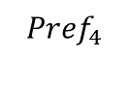
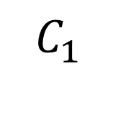
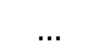
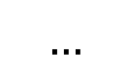
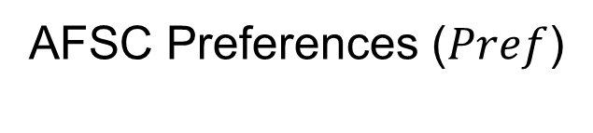
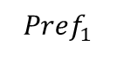
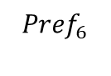
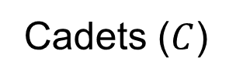
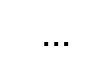
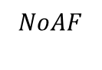
Modeling Techniques
Greedy Method
Cadets receive top choice available AFSC in order of merit
Only quotas and cadet preference are incorporated
Cadets ($C$)
AFSC Preferences ($Pref$)
$$C_{1}$$
$$…$$
$${Pref}_{4}$$
$$…$$
$$…$$
$${Pref}_{1}$$
$${Pref}_{6}$$
$$NoAF$$
NoAF: “Needs of the Air Force”

Slide 29
Modeling Techniques
Greedy Method
Cadets receive top choice available AFSC in order of merit
Only quotas and cadet preference are incorporated
Cadets ($C$)
AFSC Preferences ($Pref$)
$$C_{1}$$
$$…$$
$${Pref}_{4}$$
$$…$$
$$…$$
$${Pref}_{1}$$
$${Pref}_{6}$$
$$NoAF$$
NoAF: “Needs of the Air Force”

Slide 30
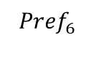
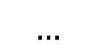
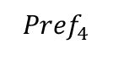

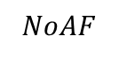
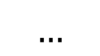
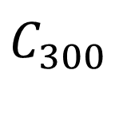
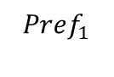
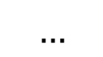
Modeling Techniques
Greedy Method
Cadets receive top choice available AFSC in order of merit
Only quotas and cadet preference are incorporated
Cadets ($C$)
AFSC Preferences ($Pref$)
$$C_{1}$$
$$…$$
$${Pref}_{4}$$
$$…$$
$$…$$
$${Pref}_{1}$$
$${Pref}_{6}$$
$$NoAF$$
$$…$$
$$C_{300}$$
$$…$$
$${Pref}_{4}$$
$$…$$
$$…$$
$${Pref}_{1}$$
$${Pref}_{6}$$
$$NoAF$$
NoAF: “Needs of the Air Force”

Slide 31
Modeling Techniques
Greedy Method
Cadets receive top choice available AFSC in order of merit
Only quotas and cadet preference are incorporated
Cadets ($C$)
AFSC Preferences ($Pref$)
$$C_{1}$$
$$…$$
$${Pref}_{4}$$
$$…$$
$$…$$
$${Pref}_{1}$$
$${Pref}_{6}$$
$$NoAF$$
$$…$$
$$C_{300}$$
$$…$$
$${Pref}_{4}$$
$$…$$
$$…$$
$${Pref}_{1}$$
$${Pref}_{6}$$
$$NoAF$$
NoAF: “Needs of the Air Force”

Slide 32
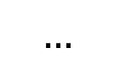

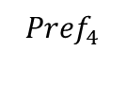
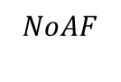
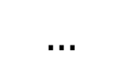
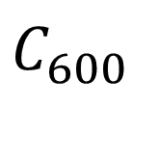
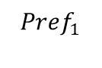
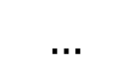
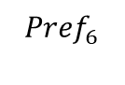
Modeling Techniques
Greedy Method
Cadets receive top choice available AFSC in order of merit
Only quotas and cadet preference are incorporated
Cadets ($C$)
AFSC Preferences ($Pref$)
$$C_{1}$$
$$…$$
$${Pref}_{4}$$
$$…$$
$$…$$
$${Pref}_{1}$$
$${Pref}_{6}$$
$$NoAF$$
$$…$$
$$C_{300}$$
$$…$$
$${Pref}_{4}$$
$$…$$
$$…$$
$${Pref}_{1}$$
$${Pref}_{6}$$
$$NoAF$$
$$…$$
$$C_{600}$$
$$…$$
$${Pref}_{4}$$
$$…$$
$$…$$
$${Pref}_{1}$$
$${Pref}_{6}$$
$$NoAF$$
NoAF: “Needs of the Air Force”

Slide 33
Modeling Techniques
Greedy Method
Cadets receive top choice available AFSC in order of merit
Only quotas and cadet preference are incorporated
Cadets ($C$)
AFSC Preferences ($Pref$)
$$C_{1}$$
$$…$$
$${Pref}_{4}$$
$$…$$
$$…$$
$${Pref}_{1}$$
$${Pref}_{6}$$
$$NoAF$$
$$…$$
$$C_{300}$$
$$…$$
$${Pref}_{4}$$
$$…$$
$$…$$
$${Pref}_{1}$$
$${Pref}_{6}$$
$$NoAF$$
$$…$$
$$C_{600}$$
$$…$$
$${Pref}_{4}$$
$$…$$
$$…$$
$${Pref}_{1}$$
$${Pref}_{6}$$
$$NoAF$$
NoAF: “Needs of the Air Force”

Slide 34
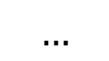
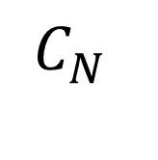
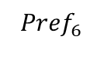
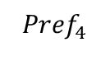
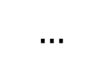
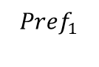
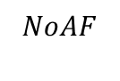

Modeling Techniques
Greedy Method
Cadets receive top choice available AFSC in order of merit
Only quotas and cadet preference are incorporated
Cadets ($C$)
AFSC Preferences ($Pref$)
$$C_{1}$$
$$…$$
$${Pref}_{4}$$
$$…$$
$$…$$
$${Pref}_{1}$$
$${Pref}_{6}$$
$$NoAF$$
$$…$$
$$C_{300}$$
$$…$$
$${Pref}_{4}$$
$$…$$
$$…$$
$${Pref}_{1}$$
$${Pref}_{6}$$
$$NoAF$$
$$…$$
$$C_{600}$$
$$…$$
$${Pref}_{4}$$
$$…$$
$$…$$
$${Pref}_{1}$$
$${Pref}_{6}$$
$$NoAF$$
$$…$$
$$C_{N}$$
$${Pref}_{1}$$
$$…$$
$${Pref}_{4}$$
$$…$$
$${Pref}_{6}$$
$$…$$
$$NoAF$$
NoAF: “Needs of the Air Force”

Slide 35
Modeling Techniques
Greedy Method
Cadets receive top choice available AFSC in order of merit
Only quotas and cadet preference are incorporated
Cadets ($C$)
AFSC Preferences ($Pref$)
$$C_{1}$$
$$…$$
$${Pref}_{4}$$
$$…$$
$$…$$
$${Pref}_{1}$$
$${Pref}_{6}$$
$$NoAF$$
$$…$$
$$C_{300}$$
$$…$$
$${Pref}_{4}$$
$$…$$
$$…$$
$${Pref}_{1}$$
$${Pref}_{6}$$
$$NoAF$$
$$…$$
$$C_{600}$$
$$…$$
$${Pref}_{4}$$
$$…$$
$$…$$
$${Pref}_{1}$$
$${Pref}_{6}$$
$$NoAF$$
$$…$$
$$C_{N}$$
$${Pref}_{1}$$
$$…$$
$${Pref}_{4}$$
$$…$$
$${Pref}_{6}$$
$$…$$
$$NoAF$$
NoAF: “Needs of the Air Force”

Slide 36
Modeling Techniques
Greedy Method
Cadets receive top choice available AFSC in order of merit
Only quotas and cadet preference are incorporated
Cadets ($C$)
AFSC Preferences ($Pref$)
$$C_{1}$$
$$…$$
$${Pref}_{4}$$
$$…$$
$$…$$
$${Pref}_{1}$$
$${Pref}_{6}$$
$$NoAF$$
$$…$$
$$C_{300}$$
$$…$$
$${Pref}_{4}$$
$$…$$
$$…$$
$${Pref}_{1}$$
$${Pref}_{6}$$
$$NoAF$$
$$…$$
$$C_{600}$$
$$…$$
$${Pref}_{4}$$
$$…$$
$$…$$
$${Pref}_{1}$$
$${Pref}_{6}$$
$$NoAF$$
$$…$$
$$C_{N}$$
$${Pref}_{1}$$
$$…$$
$${Pref}_{4}$$
$$…$$
$${Pref}_{6}$$
$$…$$
$$NoAF$$
NoAF: “Needs of the Air Force”

Slide 37
Modeling Techniques
The Stable Marriage Model
Two sets of entities place preferences for each other
Goal is to find a stable match: no two members of opposite sets prefer each other to their assigned match
For many-to-one, there is the Hospital/Residents Variant
Issues with the Model
Ordinal rankings, not utility values
Incomplete preference lists
Incorrect AFSC preference assumptions
Set 1 (Males)
Set 2 (Females)

Slide 38
Modeling Techniques
The Stable Marriage Model
Two sets of entities place preferences for each other
Goal is to find a stable match: no two members of opposite sets prefer each other to their assigned match
For many-to-one, there is the Hospital/Residents Variant
Issues with the Model
Ordinal rankings, not utility values
Incomplete preference lists
Incorrect AFSC preference assumptions
(Stable)
Set 1 (Males)
A
B
A
B
Set 2 (Females)
Preferred Partner

Slide 39
Modeling Techniques
The Stable Marriage Model
Two sets of entities place preferences for each other
Goal is to find a stable match: no two members of opposite sets prefer each other to their assigned match
For many-to-one, there is the Hospital/Residents Variant
Issues with the Model
Ordinal rankings, not utility values
Incomplete preference lists
Incorrect AFSC preference assumptions
(Unstable)
Set 1 (Males)
A
B
A
B
Set 2 (Females)
Preferred Partner

Slide 40
Modeling Techniques
The Stable Marriage Model
Two sets of entities place preferences for each other
Goal is to find a stable match: no two members of opposite sets prefer each other to their assigned match
For many-to-one, there is the Hospital/Residents Variant
Issues with the Model
Ordinal rankings, not utility values
Incomplete preference lists
Incorrect AFSC preference assumptions
Set 1 (Residents)
Set 2 (Hospitals)

Slide 41
Modeling Techniques
The Stable Marriage Model
Two sets of entities place preferences for each other
Goal is to find a stable match: no two members of opposite sets prefer each other to their assigned match
For many-to-one, there is the Hospital/Residents Variant
Issues with the Model
Ordinal rankings, not utility values
Incomplete preference lists
Incorrect AFSC preference assumptions
Set 1 (Residents)
Set 2 (Hospitals)

Slide 42
Modeling Techniques
The Assignment Problem
The generalized assignment problem found in the literature [7]
Current model uses this formulation

Slide 43
Modeling Techniques
The Assignment Problem
The generalized assignment problem found in the literature [7]
Current model uses this formulation

Slide 44
Original Methodology
The AFSC/Cadet Assignment Problem Formulation
Model follows generalized assignment problem formulation with new Air Force constraints
Objective is to maximize global utility

Slide 45
Original Methodology
The AFSC/Cadet Assignment Problem Formulation
Model follows generalized assignment problem formulation with new Air Force constraints
Objective is to maximize global utility

Slide 46
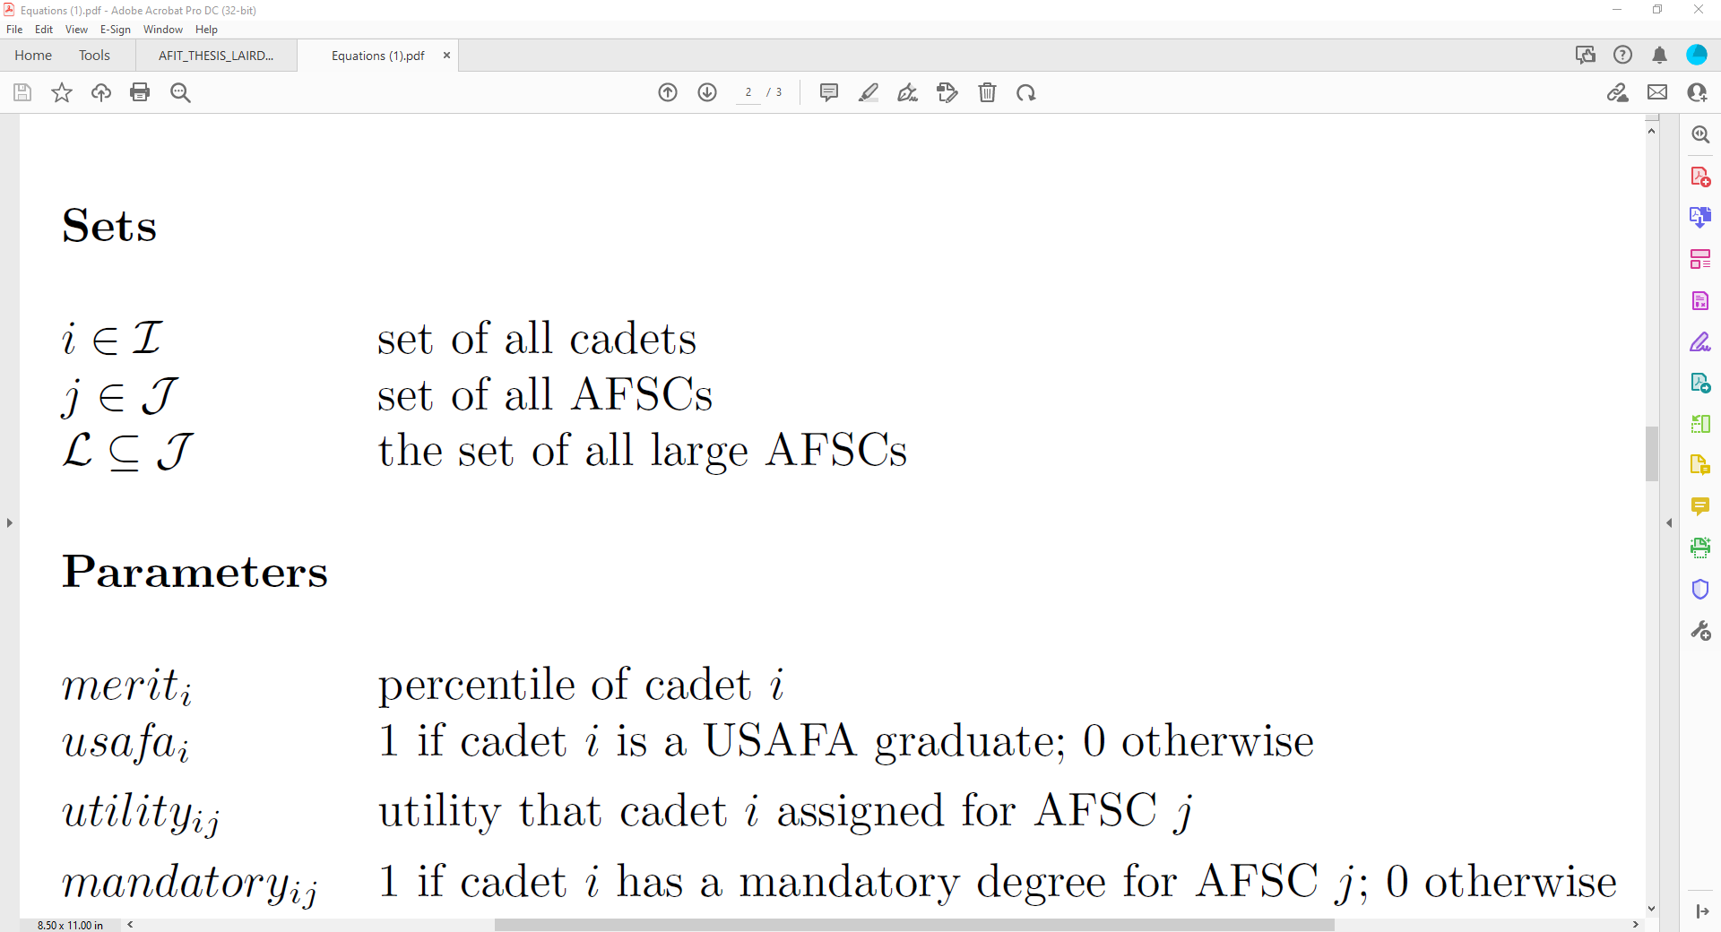
Original Methodology
The AFSC/Cadet Assignment Problem Formulation
Model follows generalized assignment problem formulation with new Air Force constraints
Objective is to maximize global utility

Slide 47
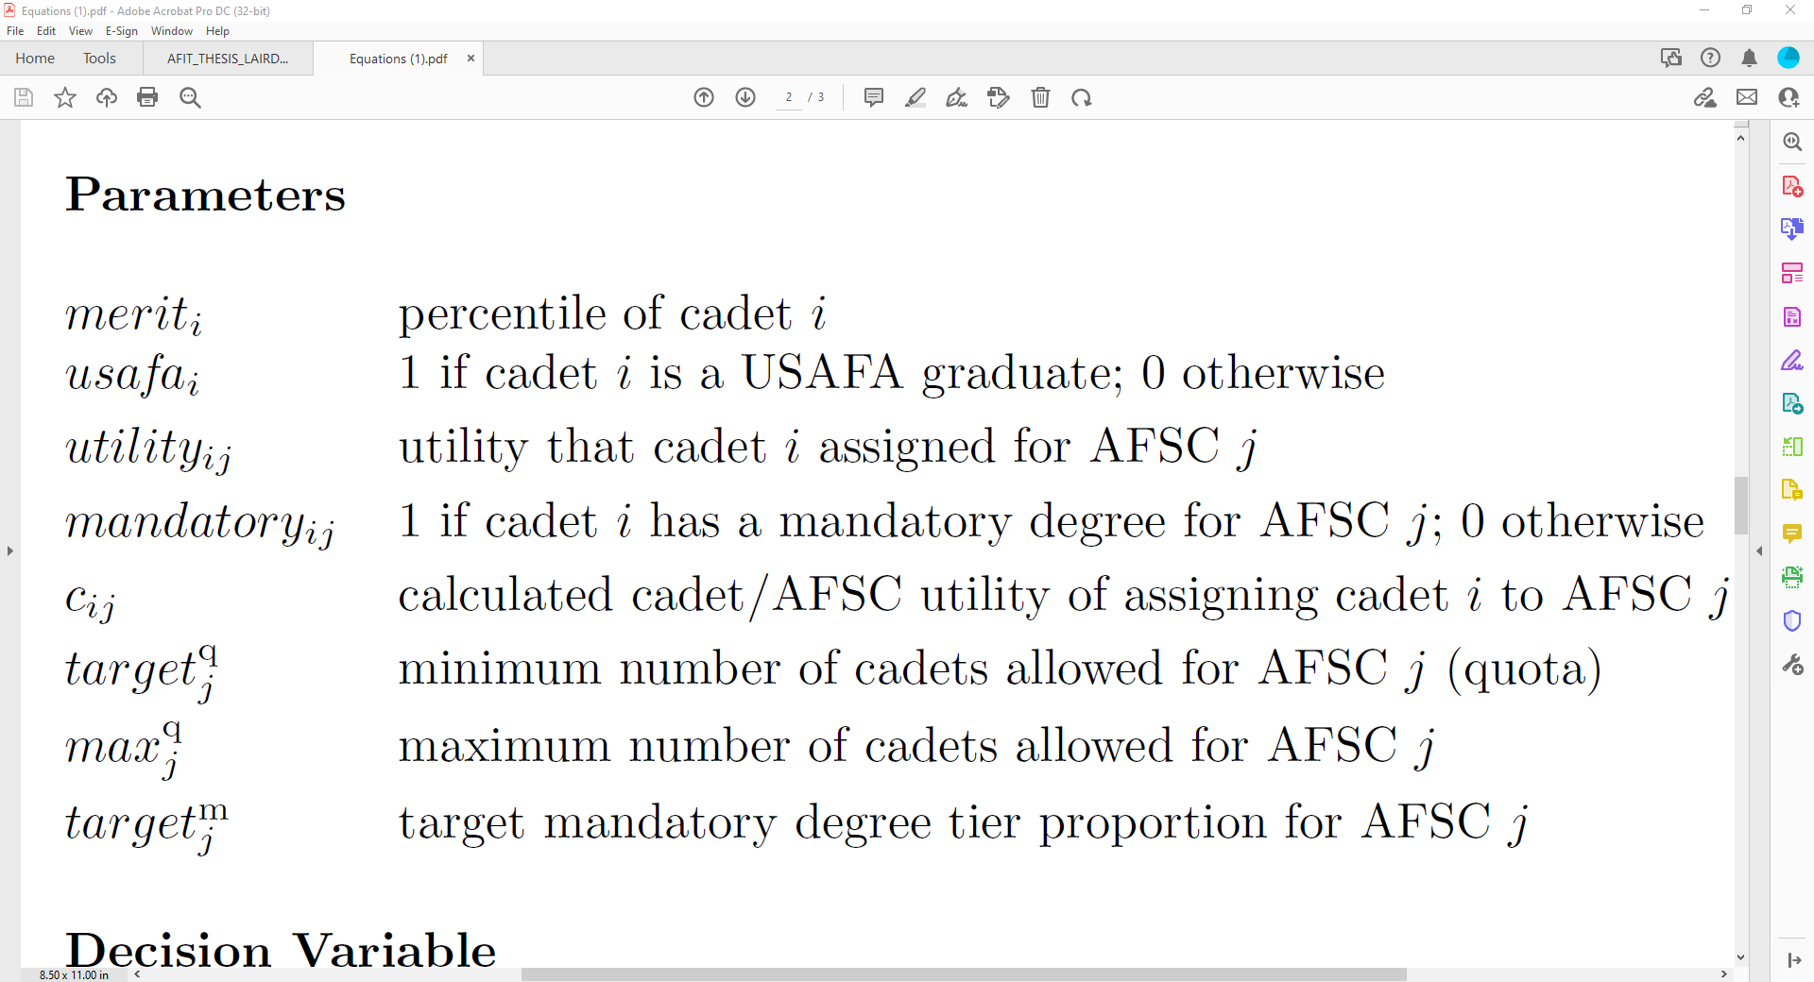
Original Methodology
The AFSC/Cadet Assignment Problem Formulation
Model follows generalized assignment problem formulation with new Air Force constraints
Objective is to maximize global utility

Slide 48
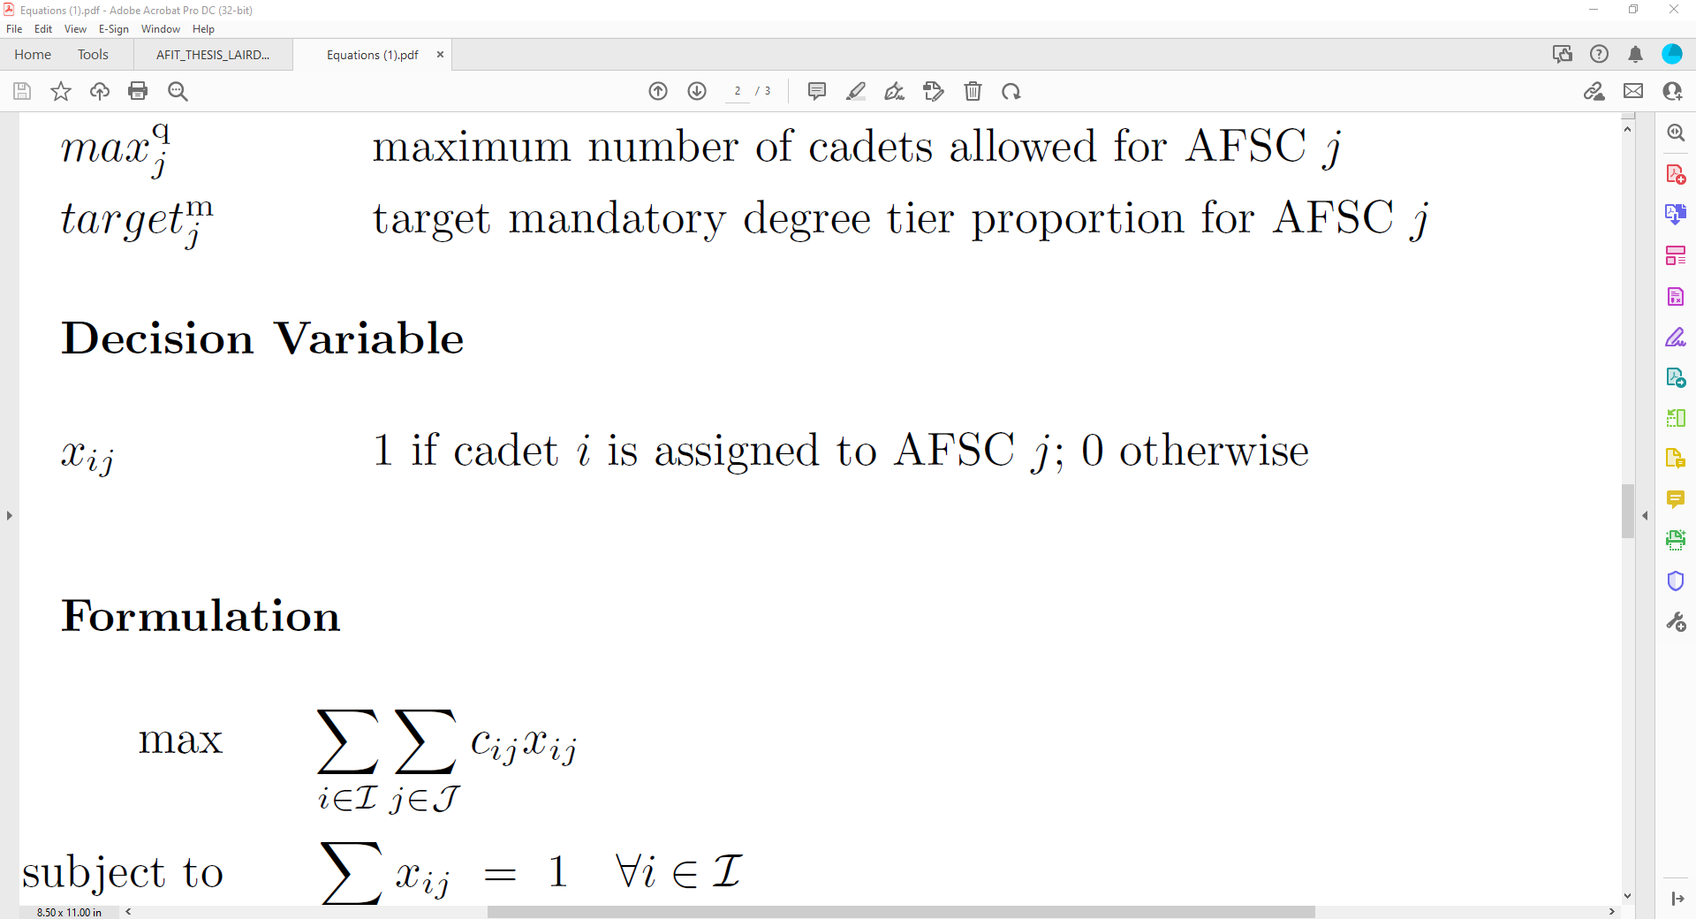
Original Methodology
The AFSC/Cadet Assignment Problem Formulation
Model follows generalized assignment problem formulation with new Air Force constraints
Objective is to maximize global utility

Slide 49
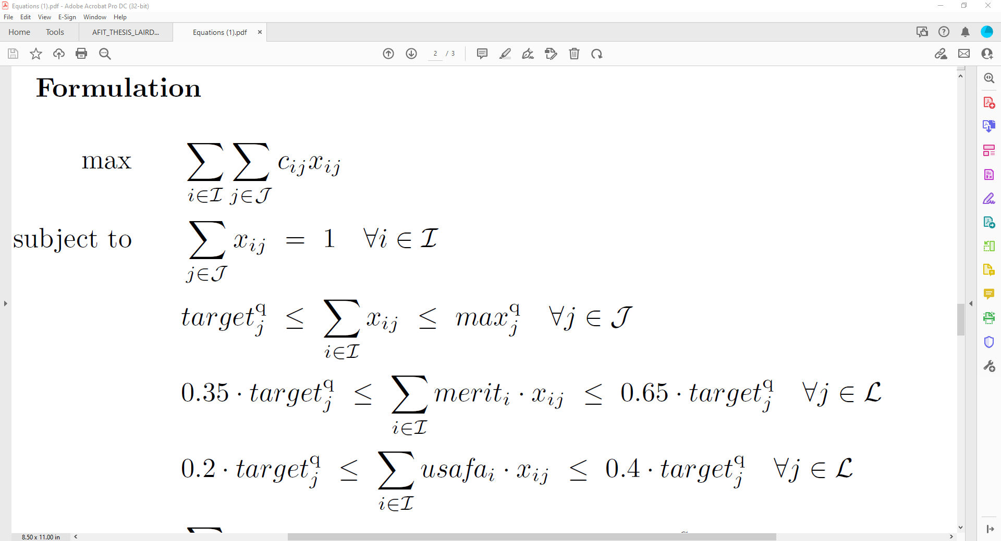
Original Methodology
The AFSC/Cadet Assignment Problem Formulation
Model follows generalized assignment problem formulation with new Air Force constraints
Objective is to maximize global utility

Slide 50
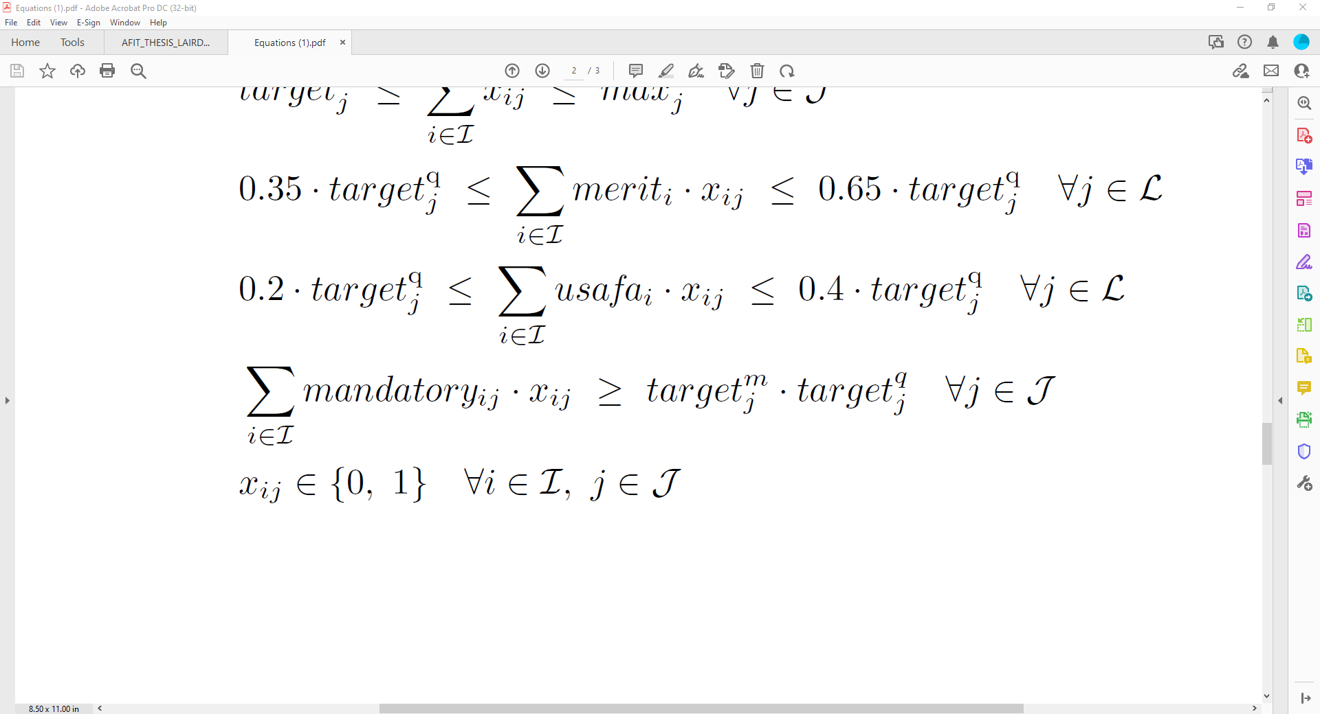
Original Methodology
The AFSC/Cadet Assignment Problem Formulation
Model follows generalized assignment problem formulation with new Air Force constraints
Objective is to maximize global utility

Slide 51
Original Methodology
The AFSC/Cadet Assignment Problem Formulation
Model follows generalized assignment problem formulation with new Air Force constraints
Objective is to maximize global utility

Slide 52
Original Methodology
The AFSC/Cadet Assignment Problem Formulation
Model follows generalized assignment problem formulation with new Air Force constraints
Objective is to maximize global utility

Slide 53
Original Methodology
The AFSC/Cadet Assignment Problem Formulation
Model follows generalized assignment problem formulation with new Air Force constraints
Objective is to maximize global utility

Slide 54
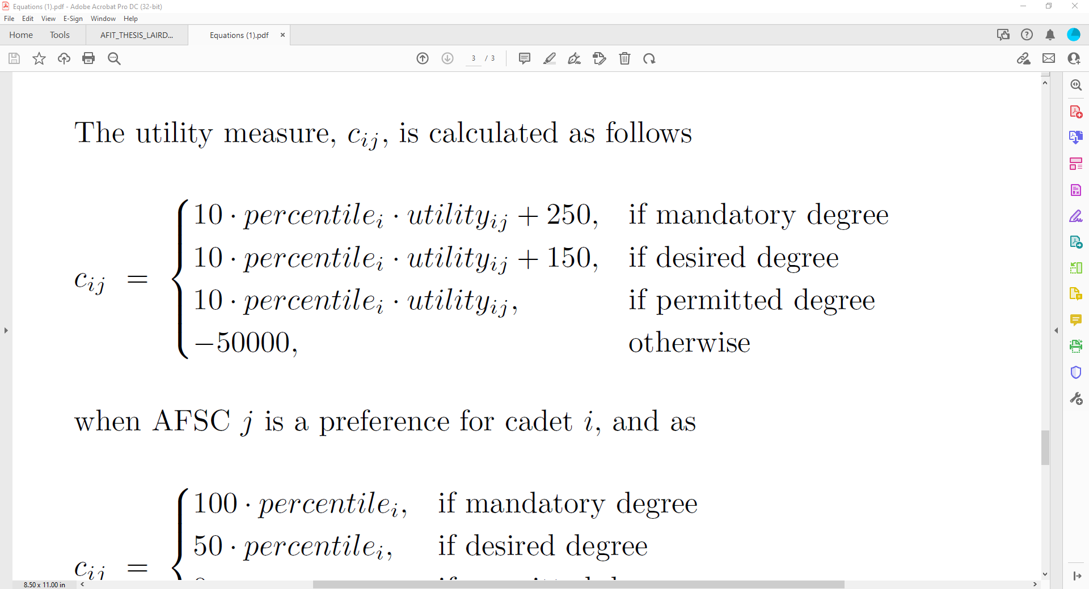
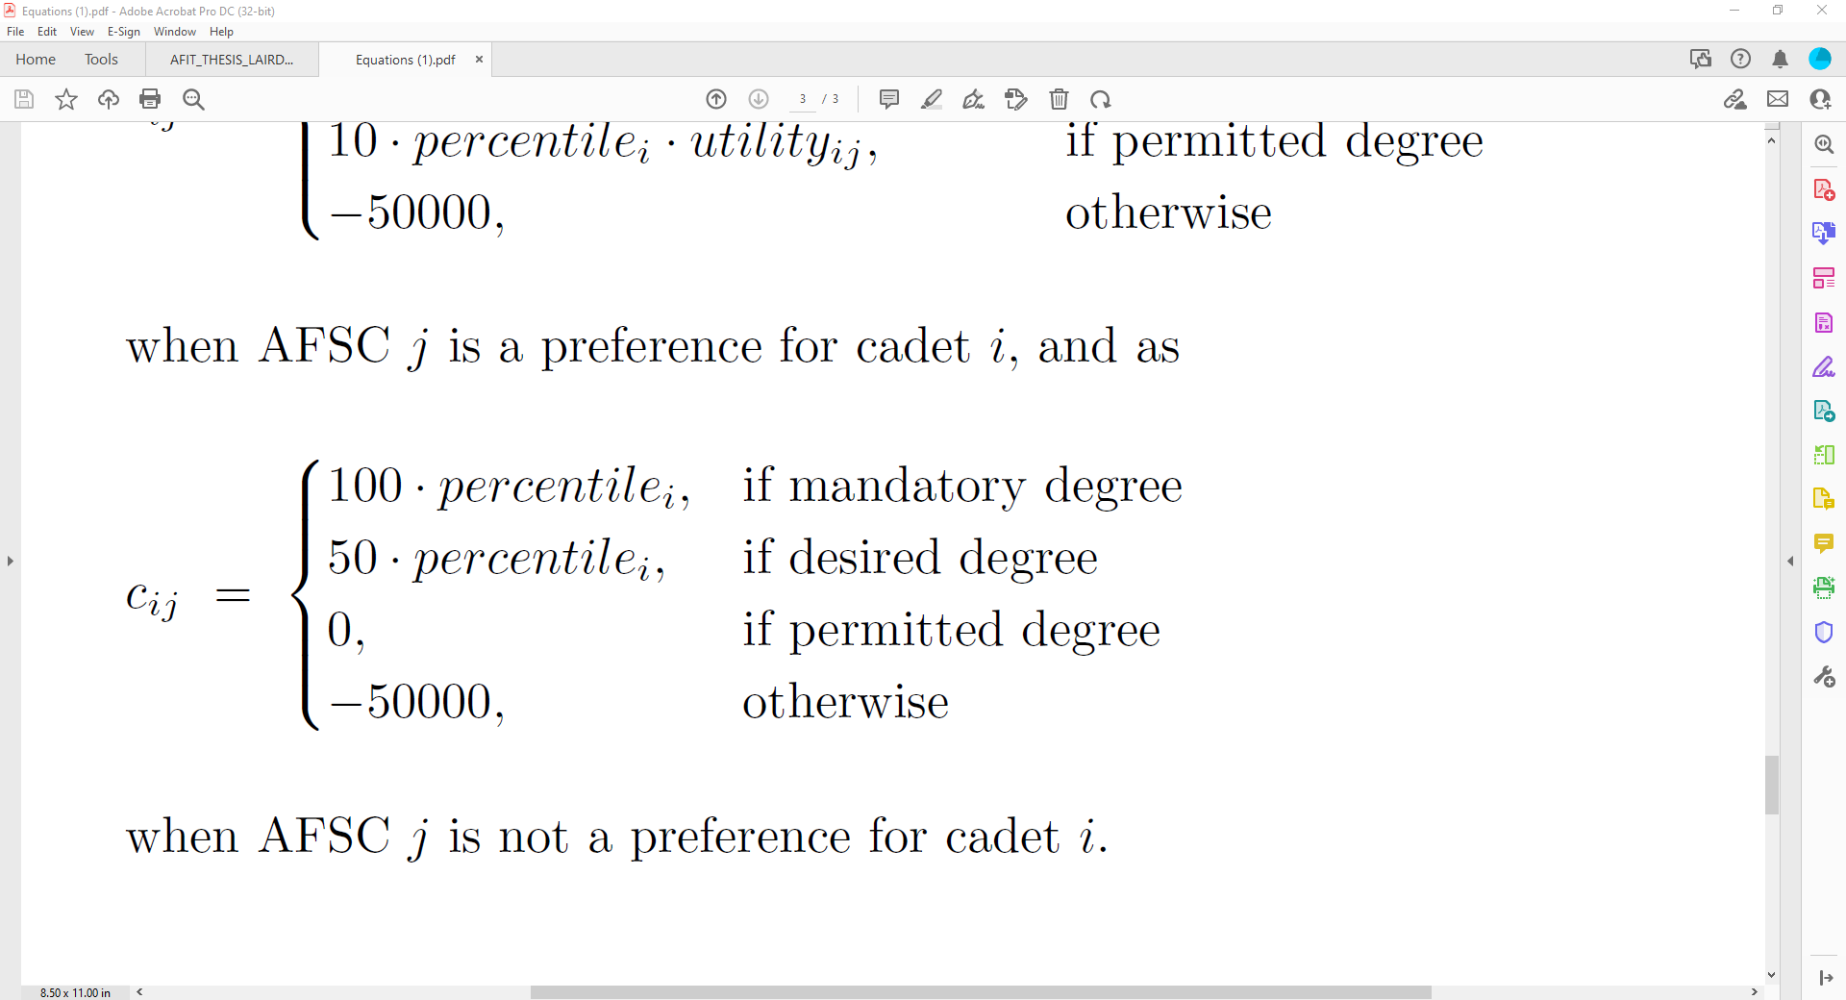
Original Methodology
The AFSC/Cadet Assignment Problem Formulation
Model follows generalized assignment problem formulation with new Air Force constraints
Objective is to maximize global utility

Slide 55
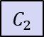
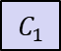
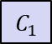
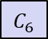
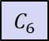
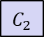
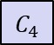
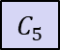
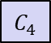
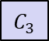

Original Methodology
Issues with Current Formulation
AFSCs prefer solution sets of cadets, not cadets individually
Eligible Cadets for AFSC “15A”
15A Preference List
$$C_{1}$$
$$C_{2}$$
$$C_{3}$$
Cadet
Rank
Degree: “Desired”
15A Utility: 75%
Percentile: 90%
SOC: USAFA
Degree: “Mandatory”
15A Utility: 40%
Percentile: 35%
SOC: ROTC
Degree: “Permitted”
15A Utility: 100%
Percentile: 75%
SOC: ROTC
$$C_{1}$$
?
$$C_{2}$$
?
$$C_{4}$$
$$C_{5}$$
$$C_{6}$$
$$C_{3}$$
?
Degree: “Mandatory”
15A Utility: 20%
Percentile: 85%
SOC: ROTC
Degree: “Permitted”
15A Utility: 60%
Percentile: 20%
SOC: USAFA
Degree: “Desired”
15A Utility: 30%
Percentile: 60%
SOC: ROTC
$$C_{4}$$
?
$$C_{5}$$
?
$$C_{6}$$
?
SOC = “Source of Commissioning”

Slide 56






Original Methodology
Issues with Current Formulation
AFSCs prefer solution sets of cadets, not cadets individually
Eligible Cadets for AFSC “15A”
15A Solution 1
15A Solution 2
$$C_{1}$$
$$C_{2}$$
$$C_{3}$$
Degree: “Desired”
15A Utility: 75%
Percentile: 90%
SOC: USAFA
Degree: “Mandatory”
15A Utility: 40%
Percentile: 35%
SOC: ROTC
Degree: “Permitted”
15A Utility: 100%
Percentile: 75%
SOC: ROTC
$$C_{1}$$
$$C_{2}$$
$$C_{3}$$
$$C_{4}$$
$$C_{2}$$
$$C_{5}$$
$$C_{6}$$
Average Merit: 0.7125
USAFA Proportion: 0.25
Mandatory Proportion: 0.5
Desired Proportion: 0.25
Permitted Proportion: 0.25
Average Utility: 0.5875
Number of Cadets: 4
Average Merit: 0.383
USAFA Proportion: 0.33
Mandatory Proportion: 0.33
Desired Proportion: 0.33
Permitted Proportion: 0.33
Average Utility: 0.433
Number of Cadets: 3
$$C_{4}$$
$$C_{5}$$
$$C_{6}$$
Degree: “Mandatory”
15A Utility: 20%
Percentile: 85%
SOC: ROTC
Degree: “Permitted”
15A Utility: 60%
Percentile: 20%
SOC: USAFA
Degree: “Desired”
15A Utility: 30%
Percentile: 60%
SOC: ROTC
SOC = “Source of Commissioning”

Slide 57




Original Methodology
Issues with Current Formulation
AFSCs prefer solution sets of cadets, not cadets individually
Eligible Cadets for AFSC “15A”
15A Solution 1
15A Solution 2
$$C_{1}$$
$$C_{2}$$
$$C_{3}$$
Degree: “Desired”
15A Utility: 75%
Percentile: 90%
SOC: USAFA
Degree: “Mandatory”
15A Utility: 40%
Percentile: 35%
SOC: ROTC
Degree: “Permitted”
15A Utility: 100%
Percentile: 75%
SOC: ROTC
$$C_{1}$$
$$C_{2}$$
$$C_{3}$$
$$C_{4}$$
$$C_{2}$$
$$C_{5}$$
$$C_{6}$$
Average Merit: 0.7125
USAFA Proportion: 0.25
Mandatory Proportion: 0.5
Desired Proportion: 0.25
Permitted Proportion: 0.25
Average Utility: 0.5875
Number of Cadets: 4
Average Merit: 0.383
USAFA Proportion: 0.33
Mandatory Proportion: 0.33
Desired Proportion: 0.33
Permitted Proportion: 0.33
Average Utility: 0.433
Number of Cadets: 3
$$C_{4}$$
$$C_{5}$$
$$C_{6}$$
Degree: “Mandatory”
15A Utility: 20%
Percentile: 85%
SOC: ROTC
Degree: “Permitted”
15A Utility: 60%
Percentile: 20%
SOC: USAFA
Degree: “Desired”
15A Utility: 30%
Percentile: 60%
SOC: ROTC
SOC = “Source of Commissioning”

Slide 58
Original Methodology
Issues with Current Formulation
AFSCs prefer solution sets of cadets, not cadets individually
Eligible Cadets for AFSC “15A”
15A Solution 1
15A Solution 2
$$C_{1}$$
$$C_{2}$$
$$C_{3}$$
Degree: “Desired”
15A Utility: 75%
Percentile: 90%
SOC: USAFA
Degree: “Mandatory”
15A Utility: 40%
Percentile: 35%
SOC: ROTC
Degree: “Permitted”
15A Utility: 100%
Percentile: 75%
SOC: ROTC
$$C_{1}$$
$$C_{2}$$
$$C_{3}$$
$$C_{4}$$
$$C_{2}$$
$$C_{5}$$
$$C_{6}$$
Average Merit: 0.7125
USAFA Proportion: 0.25
Mandatory Proportion: 0.5
Desired Proportion: 0.25
Permitted Proportion: 0.25
Average Utility: 0.5875
Number of Cadets: 4
Average Merit: 0.383
USAFA Proportion: 0.33
Mandatory Proportion: 0.33
Desired Proportion: 0.33
Permitted Proportion: 0.33
Average Utility: 0.433
Number of Cadets: 3
$$C_{4}$$
$$C_{5}$$
$$C_{6}$$
Degree: “Mandatory”
15A Utility: 20%
Percentile: 85%
SOC: ROTC
Degree: “Permitted”
15A Utility: 60%
Percentile: 20%
SOC: USAFA
Degree: “Desired”
15A Utility: 30%
Percentile: 60%
SOC: ROTC
SOC = “Source of Commissioning”

Slide 59

Original Methodology
Issues with Current Formulation
USAFA Proportion and Average Merit constraints are not accurate
The denominator should be replaced with the sum of all cadets assigned to the AFSC, not the target number of assigned cadets for the AFSC

Slide 60
Original Methodology
Issues with Current Formulation
USAFA Proportion and Average Merit constraints are not accurate
The denominator should be replaced with the sum of all cadets assigned to the AFSC, not the target number of assigned cadets for the AFSC

Slide 61
Original Methodology
Issues with Current Formulation
USAFA Proportion and Average Merit constraints are not accurate
The denominator should be replaced with the sum of all cadets assigned to the AFSC, not the target number of assigned cadets for the AFSC

Slide 62
Original Methodology
Issues with Current Formulation
The constraints almost always result in infeasible solutions

Slide 63

Original Methodology
Issues with Current Formulation
The constraints almost always result in infeasible solutions

Slide 64
New Approach
Reforming the Problem
Stable Marriage/Assignment Problem applications lack proper value-specification
Current model uses Alternative-Focused Thinking (AFT), not Value-Focused Thinking (VFT) [8]

Slide 65
New Approach
Reforming the Problem
Stable Marriage/Assignment Problem applications lack proper value-specification
Current model uses Alternative-Focused Thinking (AFT), not Value-Focused Thinking (VFT) [8]
AFT
VFT
Solutions generated based on values
Solutions generated
Values determined to measure solutions
Alternative 1
Values determined
Alternative 1
Alternative 2
Values
Values
Alternative 2
Alternative 3
Alternative 3

Slide 66
New Approach
Objective Hierarchy
Cadets have one objective: Maximize Utility
AFSCs may have up to nine objectives
Balance Merit
Balance USAFA Proportion
Meet Combined Quota
Meet USAFA Quota
Meet ROTC Quota
Meet Mandatory AFOCD degree tier target
Meet Desired AFOCD degree tier target
Meet Permitted AFOCD degree tier target
Maximize Utility of assigned cadets
Objective independence can be assumed

Slide 67
New Approach
Objective Hierarchy
Cadets have one objective: Maximize Utility
AFSCs may have up to nine objectives
Balance Merit
Balance USAFA Proportion
Meet Combined Quota
Meet USAFA Quota
Meet ROTC Quota
Meet Mandatory AFOCD degree tier target
Meet Desired AFOCD degree tier target
Meet Permitted AFOCD degree tier target
Maximize Utility of assigned cadets
Objective independence can be assumed

Slide 68
New Approach
Objective Hierarchy
Cadets have one objective: Maximize Utility
AFSCs may have up to nine objectives
Balance Merit
Balance USAFA Proportion
Meet Combined Quota
Meet USAFA Quota
Meet ROTC Quota
Meet Mandatory AFOCD degree tier target
Meet Desired AFOCD degree tier target
Meet Permitted AFOCD degree tier target
Maximize Utility of assigned cadets
Objective independence can be assumed

Slide 69
New Approach
Objective Hierarchy
Maximize Solution Quality

Slide 70
New Approach
Objective Hierarchy
Maximize Solution Quality
Maximize Cadet Solution Value

Slide 71
New Approach
Objective Hierarchy
Maximize Solution Quality
Maximize Cadet Solution Value
Maximize AFSC Solution Value

Slide 72
New Approach
Objective Hierarchy
Maximize Solution Quality
Maximize Cadet Solution Value
Maximize AFSC Solution Value
Maximize Cadet 1 Utility
Maximize Cadet N Utility
…

Slide 73
New Approach
Objective Hierarchy
Maximize Solution Quality
Maximize Cadet Solution Value
Maximize AFSC Solution Value
Maximize Cadet 1 Utility
Maximize Cadet N Utility
Maximize AFSC 1 Value
Maximize AFSC M Value
…
…

Slide 74
New Approach
Objective Hierarchy
Maximize Solution Quality
Maximize Cadet Solution Value
Maximize AFSC Solution Value
Maximize Cadet 1 Utility
Maximize Cadet N Utility
Maximize AFSC 1 Value
Maximize AFSC M Value
…
…
Maximize AFSC 1 Objective 1 Value
Maximize AFSC 1 Objective O Value
Maximize AFSC M Objective 1 Value
Maximize AFSC M Objective O Value
…
…

Slide 75

New Approach
Optimization Model
Sets and Indices
Three main sets of entities
New set for AFSC objectives

Slide 76


New Approach
Optimization Model
Sets and Indices
Three main sets of entities
New set for AFSC objectives
Cadet/AFSC constraint subsets

Slide 77
New Approach
Optimization Model
Sets and Indices
Three main sets of entities
New set for AFSC objectives
Cadet/AFSC constraint subsets
Cadet/AFSC eligibility subsets

Slide 78
New Approach
Optimization Model
Sets and Indices
Three main sets of entities
New set for AFSC objectives
Cadet/AFSC constraint subsets
Cadet/AFSC eligibility subsets
AFSC objective subsets

Slide 79
New Approach
Optimization Model
Sets and Indices
Three main sets of entities
New set for AFSC objectives
Cadet/AFSC constraint subsets
Cadet/AFSC eligibility subsets
AFSC objective subsets
AFSC objective constraint subsets

Slide 80
New Approach
Optimization Model
Sets and Indices
Three main sets of entities
New set for AFSC objectives
Cadet/AFSC constraint subsets
Cadet/AFSC eligibility subsets
AFSC objective subsets
AFSC objective constraint subsets
AFSC demographic objective subset
…
…

Slide 81
New Approach
Optimization Model
Sets and Indices
Three main sets of entities
New set for AFSC objectives
Cadet/AFSC constraint subsets
Cadet/AFSC eligibility subsets
AFSC objective subsets
AFSC objective constraint subsets
AFSC demographic objective subset
Cadets (with demographic corresponding to objective) subsets
…
…

Slide 82

New Approach
Optimization Model
Parameters
“Fixed” parameters cannot be altered

Slide 83

New Approach
Optimization Model
Parameters
“Fixed” parameters cannot be altered
“Value” parameters define value functions

Slide 84

New Approach
Optimization Model
Parameters
“Fixed” parameters cannot be altered
“Value” parameters define value functions
“Weight” parameters prescribe importance to the objectives

Slide 85

New Approach
Optimization Model
Parameters
“Fixed” parameters cannot be altered
“Value” parameters define value functions
“Weight” parameters prescribe importance to the objectives
“Constraint” parameters do not alter value hierarchy

Slide 86

New Approach
Optimization Model
Variables
Same decision variable

Slide 87

New Approach
Optimization Model
Variables
Same decision variable
Auxiliary variables defined for simplicity

Slide 88

New Approach
Optimization Model
Variables
Same decision variable
Auxiliary variables defined for simplicity

Slide 89

New Approach
Optimization Model
Variables
Same decision variable
Auxiliary variables defined for simplicity
Relationship to Objective Hierarchy
Maximize AFSC 1 Objective 1 Value

Slide 90

New Approach
Optimization Model
Variables
Same decision variable
Auxiliary variables defined for simplicity
Relationship to Objective Hierarchy
Maximize AFSC 1 Value
Maximize AFSC 1 Objective 1 Value
Maximize AFSC 1 Objective O Value
…

Slide 91
New Approach
Optimization Model
Variables
Same decision variable
Auxiliary variables defined for simplicity
Relationship to Objective Hierarchy
Maximize AFSC Solution Value
Maximize AFSC 1 Value
…
Maximize AFSC M Value
Maximize AFSC 1 Objective 1 Value
Maximize AFSC 1 Objective O Value
Maximize AFSC M Objective 1 Value
Maximize AFSC M Objective O Value
…
…

Slide 92
New Approach
Optimization Model
Variables
Same decision variable
Auxiliary variables defined for simplicity
Relationship to Objective Hierarchy
Maximize AFSC Solution Value
Maximize Cadet 1 Utility
Maximize AFSC 1 Value
…
Maximize AFSC M Value
Maximize AFSC 1 Objective 1 Value
Maximize AFSC 1 Objective O Value
Maximize AFSC M Objective 1 Value
Maximize AFSC M Objective O Value
…
…

Slide 93
New Approach
Optimization Model
Variables
Same decision variable
Auxiliary variables defined for simplicity
Relationship to Objective Hierarchy
Maximize Cadet Solution Value
Maximize AFSC Solution Value
Maximize Cadet 1 Utility
…
Maximize Cadet N Utility
Maximize AFSC 1 Value
…
Maximize AFSC M Value
Maximize AFSC 1 Objective 1 Value
Maximize AFSC 1 Objective O Value
Maximize AFSC M Objective 1 Value
Maximize AFSC M Objective O Value
…
…

Slide 94

New Approach
Optimization Model
Variables
Same decision variable
Auxiliary variables defined for simplicity
Relationship to Objective Hierarchy
Maximize Solution Quality
Maximize Cadet Solution Value
Maximize AFSC Solution Value
Maximize Cadet 1 Utility
…
Maximize Cadet N Utility
Maximize AFSC 1 Value
…
Maximize AFSC M Value
Maximize AFSC 1 Objective 1 Value
Maximize AFSC 1 Objective O Value
Maximize AFSC M Objective 1 Value
Maximize AFSC M Objective O Value
…
…

Slide 95
New Approach
Optimization Model
Formulation
Objective: Maximize Solution Quality
Maximize Solution Quality
Maximize Cadet Solution Value
Maximize AFSC Solution Value
Maximize Cadet 1 Utility
…
Maximize Cadet N Utility
Maximize AFSC 1 Value
…
Maximize AFSC M Value
Maximize AFSC 1 Objective 1 Value
Maximize AFSC 1 Objective O Value
Maximize AFSC M Objective 1 Value
Maximize AFSC M Objective O Value
…
…

Slide 96

New Approach
Optimization Model
Formulation
Objective: Maximize Solution Quality
Same basic constraints
Maximize Solution Quality
Maximize Cadet Solution Value
Maximize AFSC Solution Value
Maximize Cadet 1 Utility
…
Maximize Cadet N Utility
Maximize AFSC 1 Value
…
Maximize AFSC M Value
Maximize AFSC 1 Objective 1 Value
Maximize AFSC 1 Objective O Value
Maximize AFSC M Objective 1 Value
Maximize AFSC M Objective O Value
…
…

Slide 97
New Approach
Optimization Model
Formulation
Objective: Maximize Solution Quality
Same basic constraints
Value constraints can be added if needed
Maximize Solution Quality
Maximize Cadet Solution Value
Maximize AFSC Solution Value
Maximize Cadet 1 Utility
…
Maximize Cadet N Utility
Maximize AFSC 1 Value
…
Maximize AFSC M Value
Maximize AFSC 1 Objective 1 Value
Maximize AFSC 1 Objective O Value
Maximize AFSC M Objective 1 Value
Maximize AFSC M Objective O Value
…
…

Slide 98






New Approach
Value Hierarchy
Creating Value Functions
Assume exponential value relationship
Piece-wise exponential value functions are implemented
Non-linear function is linearized using linear “breakpoints”

Slide 99
New Approach
Value Hierarchy
Modeling Value Functions
Estimating Value Hierarchy
Real weights and values unknown
Value hierarchies are generated using estimates for parameters as expected means from normal distributions
Notes:
Up until this point we’ve discussed the objective hierarchy. Make distinction b/w objective/value hierarchy

Slide 100
New Approach
Value Hierarchy
Modeling Value Functions
Estimating Value Hierarchy
Real weights and values unknown
Value hierarchies are generated using estimates for parameters as expected means from normal distributions
Notes:
Up until this point we’ve discussed the objective hierarchy. Make distinction b/w objective/value hierarchy

Slide 101

Solution Methods
Model Complexity
Non-linear term in objective function
Cannot be factored out
Approximated with AFSC quota
Two Models: “Approximate” and “Exact”
Notes:
Objective function is non-convex!

Slide 102
Solution Methods
Model Complexity
Non-linear term in objective function
Cannot be factored out
Approximated with AFSC quota
Two Models: “Approximate” and “Exact”
Notes:
Cannot factor out the variable in the denominator

Slide 103
Solution Methods
Model Complexity
Non-linear term in objective function
Cannot be factored out
Approximated with AFSC quota
Two Models: “Approximate” and “Exact”
Notes:
I know I criticized this before…

Slide 104
Solution Methods
Model Complexity
Non-linear term in objective function
Cannot be factored out
Approximated with AFSC quota
Two Models: “Approximate” and “Exact”
Used in Approximate Model
Used in Exact Model
Notes:
The only objective function we care about is the exact model objective function!

Slide 105
Solution Methods
Solution Techniques
Conditional Tabular Generative Adversarial Network (CTGAN) applied to generate sets of cadets [11]
Historic averages used for AFSC quotas
15 datasets generated using CTGAN
Each dataset converted to 4 unique problem instances by generating different value hierarchies (sets of weight and value parameters)
Notes:
Now that we have our solvers, I need to develop my main solution methodology…
I want to generate realistic cadet data…

Slide 106
Solution Methods
Solution Techniques
Conditional Tabular Generative Adversarial Network (CTGAN) applied to generate sets of cadets [11]
Historic averages used for AFSC quotas
15 datasets generated using CTGAN
Each dataset converted to 4 unique problem instances by generating different value hierarchies (sets of weight and value parameters)

Slide 107
Solution Methods
Solution Techniques
Conditional Tabular Generative Adversarial Network (CTGAN) applied to generate sets of cadets [11]
Historic averages used for AFSC quotas
15 datasets generated using CTGAN
Each dataset converted to 4 unique problem instances by generating different value hierarchies (sets of weight and value parameters)

Slide 108
Solution Methods
Solution Techniques
Conditional Tabular Generative Adversarial Network (CTGAN) applied to generate sets of cadets [11]
Historic averages used for AFSC quotas
15 datasets generated using CTGAN
Each dataset converted to 4 unique problem instances by generating different value hierarchies (sets of weight and value parameters)
Notes:
More information on what I did with CTGAN is in the backups

Slide 109
Solution Methods
Solution Techniques
Solvers
“Coin-OR Branch and Cut” (CBC) for Approximate Model
“Interior Point Optimizer” (IPOPT) for Exact Model
Approximate model and Exact model each provide their initial solutions to Genetic Algorithm (GA)
Heuristics are incorporated as additional initial solutions
Stable Marriage Heuristic
Greedy Heuristic
GA runs for 10 minutes
Solutions compared to baseline random solution

Slide 110
Solution Methods
Solution Techniques
Solvers
“Coin-OR Branch and Cut” (CBC) for Approximate Model
“Interior Point Optimizer” (IPOPT) for Exact Model
Approximate model and Exact model each provide their initial solutions to Genetic Algorithm (GA)
Heuristics are incorporated as additional initial solutions
Stable Marriage Heuristic
Greedy Heuristic
GA runs for 10 minutes
Solutions compared to baseline random solution

Slide 111
Solution Methods
Solution Techniques
Solvers
“Coin-OR Branch and Cut” (CBC) for Approximate Model
“Interior Point Optimizer” (IPOPT) for Exact Model
Approximate model and Exact model each provide their initial solutions to Genetic Algorithm (GA)
Heuristics are incorporated as additional initial solutions
Stable Marriage Heuristic
Greedy Heuristic
GA runs for 10 minutes
Solutions compared to baseline random solution

Slide 112
Solution Methods
Solution Techniques
Solvers
“Coin-OR Branch and Cut” (CBC) for Approximate Model
“Interior Point Optimizer” (IPOPT) for Exact Model
Approximate model and Exact model each provide their initial solutions to Genetic Algorithm (GA)
Heuristics are incorporated as additional initial solutions
Stable Marriage Heuristic
Greedy Heuristic
GA runs for 10 minutes
Solutions compared to baseline random solution

Slide 113
Solution Methods
Solution Techniques
Solvers
“Coin-OR Branch and Cut” (CBC) for Approximate Model
“Interior Point Optimizer” (IPOPT) for Exact Model
Approximate model and Exact model each provide their initial solutions to Genetic Algorithm (GA)
Heuristics are incorporated as additional initial solutions
Stable Marriage Heuristic
Greedy Heuristic
GA runs for 10 minutes
Solutions compared to baseline random solution

Slide 114

Solution Methods
Solution Techniques
Averaged results across all 60 problem instances compared to averaged random solution value
GA w/Approximate
Exact
GA w/Exact
Approximate
Random

Slide 115
Model Comparison
Experiment Design
6 real class years tested
Each class year converted to 30 problem instances using different value hierarchies
30 VFT generated solutions are compared to original (real) solution
Percent improvement of VFT solution over real solution is calculated

Slide 116
Model Comparison
Experiment Design
6 real class years tested
Each class year converted to 30 problem instances using different value hierarchies
30 VFT generated solutions are compared to original (real) solution
Percent improvement of VFT solution over real solution is calculated

Slide 117
Model Comparison
Experiment Design
6 real class years tested
Each class year converted to 30 problem instances using different value hierarchies
30 VFT generated solutions are compared to original (real) solution
Percent improvement of VFT solution over real solution is calculated

Slide 118
Model Comparison
Experiment Design
6 real class years tested
Each class year converted to 30 problem instances using different value hierarchies
30 VFT generated solutions are compared to original (real) solution
Percent improvement of VFT solution over real solution is calculated

Slide 119


Model Comparison
Results
Sample Mean: 6.82%
Standard Deviation: 2.17%
95% confidence interval
$$6.51\% ≤ μ≤7.14\%$$

Slide 120
Model Comparison
Results
Solutions can be compared by their similarity
Multi-Dimensional Scaling implemented to visualize solution proximity
Similarity Plot

Slide 121
Model Comparison
Results
Solutions can be compared by their similarity
Multi-Dimensional Scaling implemented to visualize solution proximity
Similarity Plot

Slide 122

Model Comparison
Results
Solutions can be compared by their similarity
Multi-Dimensional Scaling implemented to visualize solution proximity
Similarity Plot

Slide 123
Model Comparison
Results
Solutions can be compared by their similarity
Multi-Dimensional Scaling implemented to visualize solution proximity
Similarity Plot

Slide 124

Model Comparison
Results
Solutions can be compared by their similarity
Multi-Dimensional Scaling implemented to visualize solution proximity
Similarity Plot

Slide 125

Model Comparison
Results
Solutions can be compared by their similarity
Multi-Dimensional Scaling implemented to visualize solution proximity
Similarity Plot

Slide 126

Model Comparison
Results
Solutions can be compared by their similarity
Multi-Dimensional Scaling implemented to visualize solution proximity
Similarity Plot

Slide 127

Model Comparison
Results
Solutions can be compared by their similarity
Multi-Dimensional Scaling implemented to visualize solution proximity
Similarity Plot

Slide 128

Model Comparison
Results
Solutions can be compared by their similarity
Multi-Dimensional Scaling implemented to visualize solution proximity
Similarity Plot

Slide 129

Model Comparison
Results
Solutions can be compared by their similarity
Multi-Dimensional Scaling implemented to visualize solution proximity
Similarity Plot

Slide 130

Model Comparison
Results
Solutions can be compared by their similarity
Multi-Dimensional Scaling implemented to visualize solution proximity
Similarity Plot

Slide 131

Model Comparison
Results
Solutions can be compared by their similarity
Multi-Dimensional Scaling implemented to visualize solution proximity
Similarity Plot

Slide 132
Model Comparison
Results
Solutions can be compared by their similarity
Multi-Dimensional Scaling implemented to visualize solution proximity
Similarity Plot
VFT Average Similarity: 78.2%
Original Average Similarity: 71.7%

Slide 133
Example Instance Analysis
Dashboard
Problem instance example results
 | Z | Cadets | AFSCs | Merit | USAFA | Quota | Mandatory | Desired | Permitted | Utility
Original | 0.801 | 0.823 | 0.774 | 0.736 | 0.626 | 0.916 | 0.912 | 0.471 | 0.416 | 0.625
VFT2 | 0.849 | 0.878 | 0.814 | 0.785 | 0.612 | 0.953 | 0.951 | 0.480 | 0.351 | 0.711

Slide 134
Example Instance Analysis
Dashboard
Problem instance example results
Overall Results
 | Z | Cadets | AFSCs | Merit | USAFA | Quota | Mandatory | Desired | Permitted | Utility
Original | 0.801 | 0.823 | 0.774 | 0.736 | 0.626 | 0.916 | 0.912 | 0.471 | 0.416 | 0.625
VFT2 | 0.849 | 0.878 | 0.814 | 0.785 | 0.612 | 0.953 | 0.951 | 0.480 | 0.351 | 0.711

Slide 135

Example Instance Analysis
Dashboard
Problem instance example results
AFSC Objective Results
 | Z | Cadets | AFSCs | Merit | USAFA | Quota | Mandatory | Desired | Permitted | Utility
Original | 0.801 | 0.823 | 0.774 | 0.736 | 0.626 | 0.916 | 0.912 | 0.471 | 0.416 | 0.625
VFT2 | 0.849 | 0.878 | 0.814 | 0.785 | 0.612 | 0.953 | 0.951 | 0.480 | 0.351 | 0.711

Slide 136

Example Instance Analysis
Individual Value on Each AFSC (VFT2 Solution)

Slide 137

Example Instance Analysis
Average Utility of Cadets Assigned to Each AFSC (VFT2 Solution)

Slide 138

Example Instance Analysis
Cadet Utility Histogram (VFT2 Solution)

Slide 139
Conclusions
Summary
Optimization using a VFT framework more accurately captures decision-maker value trade-offs
Model is intuitive by nature
Metaheuristic solution technique incorporated to find better solutions quicker
Future Work
Better approximation techniques
More effective solution methodology
More discussions with decision-makers on their values for solutions
More than one cadet objective

Slide 140
Conclusions
Summary
Optimization using a VFT framework more accurately captures decision-maker value trade-offs
Model is intuitive by nature
Metaheuristic solution technique incorporated to find better solutions quicker
Future Work
Better approximation techniques
More effective solution methodology
More discussions with decision-makers on their values for solutions
More than one cadet objective

Slide 141
References
Andrew P. Armacost and James K. Lowe. Decision support for the career ﬁeld selection process at the US Air Force Academy. European Journal of Operational Research, 160(3):839–850, Feb 2005.
D. Gale and L. S. Shapley. College admissions and the stability of marriage. The American Mathematical Monthly, 69(1):9–15, Jan 1962.
Robert W. Irving, Paul Leather, and Dan Gusﬁeld. An eﬃcient algorithm for the “optimal” stable marriage. Journal of the ACM (JACM), 34(3):532–543, Jul 1987.
D. G. McVitie and L. B. Wilson. The stable marriage problem. Communications of the ACM, 14(7):486–490, Jul 1971.
Alvin E. Roth and Marilda Sotomayor. The college admissions problem revisited. Econometrica, 57(3):559, May 1989.
Pter Bir, Tams Fleiner, Robert W. Irving, and David F. Manlove. The college admissions problem with lower and common quotas. Theoretical Computer Science, 411(34-36):3136–3153, Jul 2010.
Dirk G. Cattrysse and Luk N. Van Wassenhove. A survey of algorithms for the generalized assignment problem. European Journal of Operational Research, 60(3):260–272, Aug 1992.
Ralph L. Keeney. Value-Focused Thinking: a path to creative decisionmaking. Long Range Planning, 30(2):314, 1997.

Slide 142
References
Ralph L. Keeney. Making better decision makers. Decision Analysis, 1(4):193–204, 2004.
Der San Chen, Robert G. Batson, and Yu Dang. Applied integer programming: modeling and solution. Applied Integer Programming: Modeling and Solution, Sep 2011.
Lei Xu, Maria Skoularidou, Alfredo Cuesta-Infante, and Kalyan Veeramachaneni. Modeling tabular data using conditional GAN.

Slide 143


Questions

Slide 144
Presentation Links
Problem Description
AFSC Quotas
AFSC Qualifications
Balancing Objectives
Cadet Utility
Modeling Techniques
Greedy Method
Stable Marriage Model
Assignment Problem
Original Methodology
Definitions
Formulation
Issues
New Approach
Reforming the Problem
Objective Definitions
Objective Hierarchy
Optimization Model
Sets
Parameters
Variables
Formulation
Value Hierarchy
Solution Methods
Model Complexity
Solution Technique
Model Comparison
Experiment Design
Results (Histogram)
Results (Similarity)
Instance Analysis
Instance Results
Cadet Utility Histogram
Conclusions

Slide 145
Backup Slides
Issues with the Stable Marriage Model (in presentation)
Dashboard (in presentation)
Sensitivity Analysis
The Generalized Assignment Problem
More Issues with the Current Model (in presentation)
Creating Value Functions
Modeling Value Functions (in presentation)
Estimating Value Hierarchy (in presentation)
Data Generation (in presentation)
Genetic Algorithm (in presentation)
Solver Selection (in presentation)
Cadet Utility Histogram Explanation
More Instance Analysis

Slide 146

Model Dashboard

Slide 147
The Stable Marriage Model
The Stable Marriage/Matching Problem (One-to-One)
Two sets of entities place preferences for each other
Goal is to find a stable match: no two members of opposite sets prefer each other to their assigned match
Stable Marriage Algorithm, invented by David Gale and Lloyd Shapley [2], ensures such a match
Set 1 (Males)
Set 2 (Females)

Slide 148
The Stable Marriage Model
The Stable Marriage/Matching Problem (One-to-One)
Two sets of entities place preferences for each other
Goal is to find a stable match: no two members of opposite sets prefer each other to their assigned match
Stable Marriage Algorithm, invented by David Gale and Lloyd Shapley [2], ensures such a match
(Stable)
Set 1 (Males)
A
B
A
B
Set 2 (Females)
Preferred Partner

Slide 149
The Stable Marriage Model
The Stable Marriage/Matching Problem (One-to-One)
Two sets of entities place preferences for each other
Goal is to find a stable match: no two members of opposite sets prefer each other to their assigned match
Stable Marriage Algorithm, invented by David Gale and Lloyd Shapley [2], ensures such a match
(Unstable)
Set 1 (Males)
A
B
A
B
Set 2 (Females)
Preferred Partner

Slide 150
The Stable Marriage Model
The Stable Marriage/Matching Problem (One-to-One)
Two sets of entities place preferences for each other
Goal is to find a stable match: no two members of opposite sets prefer each other to their assigned match
Stable Marriage Algorithm, invented by David Gale and Lloyd Shapley [2], ensures such a match
Set 1 (Males)
Set 2 (Females)

Slide 151

The Stable Marriage Model
The Stable Marriage/Matching Problem (Many-to-One)
$N$ entities of one set are matched to $M$ entities of another set (hospital/resident problem variant)
Hospitals have maximum capacity
If preference lists are incomplete, some residents/hospitals may go unmatched
Set 1 (Residents)
Set 2 (Hospitals)

Slide 152

The Stable Marriage Model
The Stable Marriage/Matching Problem (Many-to-One)
$N$ entities of one set are matched to $M$ entities of another set (hospital/resident problem variant)
Hospitals have maximum capacity
If preference lists are incomplete, some residents/hospitals may go unmatched
Set 1 (Residents)
Set 2 (Hospitals)

Slide 153

The Stable Marriage Model
The Stable Marriage/Matching Problem (Many-to-One)
$N$ entities of one set are matched to $M$ entities of another set (hospital/resident problem variant)
Hospitals have maximum capacity
If preference lists are incomplete, some residents/hospitals may go unmatched
Set 1 (Residents)
Set 2 (Hospitals)

Slide 154

The Assignment Problem
The Assignment Problem
The generalized assignment problem found in the literature [7]
Current model uses this formulation

Slide 155
The Assignment Problem
The Assignment Problem
The generalized assignment problem found in the literature [7]
Current model uses this formulation

Slide 156

The Assignment Problem
The Assignment Problem
The generalized assignment problem found in the literature [7]
Current model uses this formulation

Slide 157

The Assignment Problem
The Assignment Problem
The generalized assignment problem found in the literature [7]
Current model uses this formulation

Slide 158
Issues with Current Methodology
Model Issues
The utility function does not accurately depict real AFSC/Cadet utilities
Arbitrary value specifications
Inconsistencies in values
All AFSCs are assumed to be the same
AFSC objectives are blended
Big M does not always constrain eligibility

Slide 159
Issues with Current Methodology
Model Issues
The utility function does not accurately depict real AFSC/Cadet utilities
Arbitrary value specifications
Inconsistencies in values
All AFSCs are assumed to be the same
AFSC objectives are blended
Big M does not always constrain eligibility

Slide 160
Issues with Current Methodology
Model Issues
The utility function does not accurately depict real AFSC/Cadet utilities
Arbitrary value specifications
Inconsistencies in values
All AFSCs are assumed to be the same
AFSC objectives are blended
Big M does not always constrain eligibility

Slide 161
Issues with Current Methodology
Model Issues
The utility function does not accurately depict real AFSC/Cadet utilities
Arbitrary value specifications
Inconsistencies in values
All AFSCs are assumed to be the same
AFSC objectives are blended
Big M does not always constrain eligibility

Slide 162
Issues with Current Methodology
Model Issues
The utility function does not accurately depict real AFSC/Cadet utilities
Arbitrary value specifications
Inconsistencies in values
All AFSCs are assumed to be the same
AFSC objectives are blended
Big M does not always constrain eligibility
(for all cadets and AFSCs)

Slide 163
Issues with Current Methodology
Model Issues
The utility function does not accurately depict real AFSC/Cadet utilities
Arbitrary value specifications
Inconsistencies in values
All AFSCs are assumed to be the same
AFSC objectives are blended
Big M does not always constrain eligibility

Slide 164
Issues with Current Methodology
Model Issues
The utility function does not accurately depict real AFSC/Cadet utilities
Arbitrary value specifications
Inconsistencies in values
All AFSCs are assumed to be the same
AFSC objectives are blended
Big M does not always constrain eligibility

Slide 165

Issues with Current Methodology
Model Issues
AFSCs are not the same

Slide 166

Issues with Current Methodology
Model Issues
AFSCs are not the same

Slide 167

Issues with Current Methodology
Model Issues
Two different objectives represented by USAFA constraint
Constrained minimum number of USAFA cadets
Constrained USAFA proportion
Example
Targets
USAFA Quota: 2 cadets
ROTC Quota: 6 cadets
Combined Quota: 8 cadets
Maximum: 14 cadets
2 USAFA cadets,
8 ROTC cadets
10 Total cadets
20%
USAFA
80%
ROTC
Entire Class
AFSC Solution
These are separate objectives!

Slide 168
More Stable Marriage Issues
Issues with Stable Marriage for AFSC/Cadet Problem
Preferences are ordinal rankings, not utility measures
Incomplete preference lists do not work
AFSC constraints are a problem
1
2
3
…
vs
100%
90%
75%
…

Slide 169
More Stable Marriage Issues
Issues with Stable Marriage for AFSC/Cadet Problem
Preferences are ordinal rankings, not utility measures
Incomplete preference lists do not work
AFSC constraints are a problem
Cadet A’s Preferences
AFSC
Rank
15A
1
14N
2
63A
3
17D
4

Slide 170
More Stable Marriage Issues
Issues with Stable Marriage for AFSC/Cadet Problem
Preferences are ordinal rankings, not utility measures
Incomplete preference lists do not work
AFSC constraints are a problem

Slide 171
More Stable Marriage Issues
Problem Assumptions
Ordinal rankings are used
Only upper bounds on the allowable number of residents are given
Objective is to find a stable match
Issues with the Stable Marriage Algorithm
Finds “male-optimal” solution, since the men get to propose to their top choices and women only get to accept their best offer [4]
No guaranteed global optimal solution (only stable solution) [5]
“Group-stability” in the case of many-to-one matching refers to the hospital’s preference over the group of residents, rather than individuals. This leads to strong and weak stability, further complicating the problem [6]
Lower bounds result in the potential for no stable matching [7]

Slide 172


More Stable Marriage Issues
Issues with Stable Marriage for AFSC/Cadet Problem
Cadets have no way of providing trade offs/indifference measures between AFSCs
Only ordinal rankings are used
Does not capture true value/utility gained from AFSC received
Incomplete preference lists
Cadets traditionally submit 6 preferences
Does the stable marriage model use incomplete preferences? This would mean cadets can only be assigned AFSCs on their lists. Likely this would not be the case, so the remaining ~26 AFSCs would be arbitrarily sorted for each cadet, which is not accurate
With a utility matrix, AFSCs for which a cadet has placed a utility of 0 will all equally be undesirable. In the stable marriage context, preference 7 $≻$ preference 8 $≻$ preference 9 … etc.
$≻$ = “is preferred to” or “succeeds”

Slide 173
More Stable Marriage Issues
Issues with Stable Marriage for AFSC/Cadet Problem
Constraints
Given the numerous objectives/constraints that are specified, how does the algorithm ensure these criteria are met?
Quotas are easy, but what about balancing AFOCD proportions, merit, source of commissioning, etc.?
Hospital/Residents problem allows for quotas to go unfilled and some residents to not be matched to hospitals and vice versa, which is not acceptable for the AFSC/Cadet problem
No objective function by which to compare solutions

Slide 174
More Instance Analysis
Instance Results
More weight on Merit, USAFA Proportion
Less weight on Cadets
 | Z | Cadets | AFSCs | Merit | USAFA | Quota | Mandatory | Desired | Permitted | Utility
Original | 0.797 | 0.823 | 0.786 | 0.770 | 0.665 | 0.909 | 0.912 | 0.477 | 0.410 | 0.642
VFT1 | 0.840 | 0.847 | 0.837 | 0.860 | 0.663 | 0.992 | 0.949 | 0.498 | 0.341 | 0.702

Slide 175

More Instance Analysis
Average Merit of Cadets Assigned to Each AFSC (VFT1 Solution)

Slide 176
More Instance Analysis
Average Merit of Cadets Assigned to Each AFSC (VFT1 Solution)
Closer to 0.5

Slide 177

More Instance Analysis
Average Merit of Cadets Assigned to Each AFSC (VFT2 Solution)
Further from 0.5

Slide 178
More Instance Analysis
Average Merit of Cadets Assigned to Each AFSC (VFT2 Solution)

Slide 179

Sensitivity Analysis
Sensitivity Analysis
Pareto Optimality
AFSC Objective Weights

Slide 180
Sensitivity Analysis
Sensitivity Analysis
Pareto Optimality
AFSC Objective Weights

Slide 181

Sensitivity Analysis
Sensitivity Analysis
Notes:
Let’s say we have two solutions: b and t. We also have a set of weights. Presumably, solution b is the VFT solution generated by the value hierarchy that uses weights b. Solution t is the original solution…

Slide 182


Creating Value Functions
Value Hierarchy
Creating Value Functions
Assume exponential value relationship
$$y= \frac{1 −e^{\frac{−(x −x_{i})}{ρ}}}{1−e^{\frac{−(x_{f} −x_{i})}{ρ}}}$$

Slide 183

Creating Value Functions
Value Hierarchy
Creating Value Functions
Assume exponential value relationship
$$y= \frac{1 −e^{\frac{−(x −0)}{ρ}}}{1−e^{\frac{−(10 − 0)}{ρ}}}$$

Slide 184

Creating Value Functions
Value Hierarchy
Creating Value Functions
Assume exponential value relationship
$$y= \frac{1 −e^{\frac{−x}{ρ}}}{1−e^{\frac{−10}{ρ}}}$$

Slide 185
Creating Value Functions
Value Hierarchy
Creating Value Functions
Assume exponential value relationship
$$y= \frac{1 −e^{\frac{−x}{ρ}}}{1−e^{\frac{−10}{ρ}}}$$

Slide 186

Creating Value Functions
Value Hierarchy
Creating Value Functions
Assume exponential value relationship
$$y= \frac{1 −e^{\frac{−x}{−2}}}{1−e^{\frac{−10}{−2}}}$$

Slide 187


Creating Value Functions
Value Hierarchy
Creating Value Functions
Assume exponential value relationship
$$y= \frac{1 −e^{\frac{−x}{−4}}}{1−e^{\frac{−10}{−4}}}$$

Slide 188


Creating Value Functions
Value Hierarchy
Creating Value Functions
Assume exponential value relationship
$$y= \frac{1 −e^{\frac{−x}{−0.5}}}{1−e^{\frac{−10}{−0.5}}}$$

Slide 189


Creating Value Functions
Value Hierarchy
Creating Value Functions
Assume exponential value relationship
$$y= \frac{1 −e^{\frac{−x}{2}}}{1−e^{\frac{−10}{2}}}$$

Slide 190
Creating Value Functions
Value Hierarchy
Creating Value Functions
Assume exponential value relationship
Piece-wise exponential value functions are implemented

Slide 191

Creating Value Functions
Value Hierarchy
Creating Value Functions
Assume exponential value relationship
Piece-wise exponential value functions are implemented

Slide 192

Creating Value Functions
Value Hierarchy
Creating Value Functions
Assume exponential value relationship
Piece-wise exponential value functions are implemented

Slide 193
Creating Value Functions
Value Hierarchy
Creating Value Functions
Assume exponential value relationship
Piece-wise exponential value functions are implemented

Slide 194
Creating Value Functions
Value Hierarchy
Creating Value Functions
Assume exponential value relationship
Piece-wise exponential value functions are implemented
Segment “breakpoints” are incorporated to connect each exponential function

Slide 195

Creating Value Functions
Value Hierarchy
Creating Value Functions
Assume exponential value relationship
Piece-wise exponential value functions are implemented
Segment “breakpoints” are incorporated to connect each exponential function

Slide 196

Creating Value Functions
Value Hierarchy
Creating Value Functions
Assume exponential value relationship
Piece-wise exponential value functions are implemented
Segment “breakpoints” are incorporated to connect each exponential function
Non-linear function is linearized based on the number of breakpoints required

Slide 197

Creating Value Functions
Value Hierarchy
Creating Value Functions
Assume exponential value relationship
Piece-wise exponential value functions are implemented
Segment “breakpoints” are incorporated to connect each exponential function
Non-linear function is linearized based on the number of breakpoints required

Slide 198

Creating Value Functions
Value Hierarchy
Creating Value Functions
Assume exponential value relationship
Piece-wise exponential value functions are implemented
Segment “breakpoints” are incorporated to connect each exponential function
Non-linear function is linearized based on the number of breakpoints required

Slide 199
Creating Value Functions
Value Hierarchy
Creating Value Functions
Assume exponential value relationship
Piece-wise exponential value functions are implemented
Segment “breakpoints” are incorporated to connect each exponential function
Non-linear function is linearized based on the number of breakpoints required

Slide 200

Creating Value Functions
Value Hierarchy
Creating Value Functions
Assume exponential value relationship
Piece-wise exponential value functions are implemented
Segment “breakpoints” are incorporated to connect each exponential function
Non-linear function is linearized based on the number of breakpoints required

Slide 201

Creating Value Functions
Value Hierarchy
Creating Value Functions
Assume exponential value relationship
Piece-wise exponential value functions are implemented
Segment “breakpoints” are incorporated to connect each exponential function
Non-linear function is linearized based on the number of breakpoints required

Slide 202


Modeling Value Functions
Value Hierarchy
Modeling Value Functions [10]

Slide 203



Modeling Value Functions
Value Hierarchy
Modeling Value Functions [10]
3
2
4
1
5

Slide 204

Modeling Value Functions
Value Hierarchy
Modeling Value Functions [10]
3
2
4
1
5

Slide 205



Modeling Value Functions
Value Hierarchy
Modeling Value Functions [10]
2

Slide 206

Modeling Value Functions
Value Hierarchy
Modeling Value Functions [10]
Breakpoint
1
2
3
4
5
0.0
0.2
0.5
0.8
1.0
Measure

Slide 207
Modeling Value Functions
Value Hierarchy
Modeling Value Functions [10]
Breakpoint
1
2
3
4
5
0.0
0.2
0.4
0.5
0.8
1.0
Measure

Slide 208

Modeling Value Functions
Value Hierarchy
Modeling Value Functions [10]
Breakpoint
1
2
3
4
5
0.0
0.2
0.4
0.5
0.8
1.0
Measure
$$λ_{jk2}=\frac{0.5−0.4}{0.5−0.2}=\frac{1}{3}$$

Slide 209

Modeling Value Functions
Value Hierarchy
Modeling Value Functions [10]
Breakpoint
1
2
3
4
5
0.0
0.2
0.4
0.5
0.8
1.0
Measure
$$y_{jk2}=1$$

Slide 210


Modeling Value Functions
Value Hierarchy
Modeling Value Functions [10]

Slide 211

Modeling Value Functions
Value Hierarchy
Modeling Value Functions [10]

Slide 212

Modeling Value Functions
Value Hierarchy
Modeling Value Functions [10]

Slide 213

Modeling Value Functions
Value Hierarchy
Modeling Value Functions [10]

Slide 214

Estimating Value Hierarchy
Value Hierarchy
Estimating Value Functions
Functions depend on the set of eligible cadets for each AFSC
Example AFSC Value Functions

Slide 215

Estimating Value Hierarchy
Value Hierarchy
Estimating Value Functions
Functions depend on the set of eligible cadets for each AFSC
Example AFSC Value Functions

Slide 216

Estimating Value Hierarchy
Value Hierarchy
Estimating Value Functions
Functions depend on the set of eligible cadets for each AFSC
Example AFSC Value Functions

Slide 217

Estimating Value Hierarchy
Value Hierarchy
Estimating Value Functions
Functions depend on the set of eligible cadets for each AFSC
Example AFSC Value Functions

Slide 218

Estimating Value Hierarchy
Value Hierarchy
Estimating Value Functions
Functions depend on the set of eligible cadets for each AFSC
Example AFSC Value Functions

Slide 219

Estimating Value Hierarchy
Value Hierarchy
Estimating Objective Weights
Local AFSC objective weight: each sampled from normal distributions with expected means
Local AFSC weight: determined through function of quota
Local cadet weight: determined through function of percentile
Overall cadet weight: sampled from a normal distribution with mean 0.35

Slide 220

Estimating Value Hierarchy
Value Hierarchy
Estimating Objective Weights
Local AFSC objective weight: each sampled from normal distributions with expected means
Local AFSC weight: determined through function of quota
Local cadet weight: determined through function of percentile
Overall cadet weight: sampled from a normal distribution with mean 0.35

Slide 221

Estimating Value Hierarchy
Value Hierarchy
Estimating Objective Weights
Local AFSC objective weight: each sampled from normal distributions with expected means
Local AFSC weight: determined through function of quota
Local cadet weight: determined through function of percentile
Overall cadet weight: sampled from a normal distribution with mean 0.35

Slide 222

Estimating Value Hierarchy
Value Hierarchy
Estimating Objective Weights
Local AFSC objective weight: each sampled from normal distributions with expected means
Local AFSC weight: determined through function of quota
Local cadet weight: determined through function of percentile
Overall cadet weight: sampled from a normal distribution with mean 0.35

Slide 223

Estimating Value Hierarchy
Value Hierarchy
Estimating Objective Weights
Local AFSC objective weight: each sampled from normal distributions with expected means
Local AFSC weight: determined through function of quota
Local cadet weight: determined through function of percentile
Overall cadet weight: sampled from a normal distribution with mean 0.35

Slide 224
Estimating Value Hierarchy
Value Hierarchy
Estimating Objective Weights
Local AFSC objective weight: each sampled from normal distributions with expected means
Local AFSC weight: determined through function of quota
Local cadet weight: determined through function of percentile
Overall cadet weight: sampled from a normal distribution with mean 0.35

Slide 225
Data Generation
Datasets generated using Conditional Tabular Generative Adversarial Network (CTGAN) [10]
Used to support the selection of the implemented solution methodology

Slide 226
Data Generation
Dataset Example
CIPs can be used to get cadet qualifications for each AFSC
First preference utility is removed (column of 1s)
USAFA | percentile | Util2 | Pref1 | Pref2 | CIP1 | CIP2
1 | 0.76 | 0.91 | 15A | 21M | 140201
0 | 0.53 | 0.84 | 17D | 15A | 110701
0 | 0.34 | 0.75 | 21M | 17D | 450901 | 450201
1 | 0.24 | 0.68 | 17D | 21M | 290207

Slide 227
Data Generation
Results
“KS/KL” score is a statistic that combines the Kolmogorov-Smirnov test statistic with the Kullback-Leibler divergence
 | KS/KL Score | N | USAFA Proportion | Average Merit | Util2 Avg | Util3 Avg | Util4 Avg | Util5 Avg | Util6 Avg
Base | N/A | 7413 | 0.29 | 0.50 | 0.76 | 0.57 | 0.42 | 0.30 | 0.22
CTGAN | 0.65 | 1451 | 0.26 | 0.50 | 0.74 | 0.52 | 0.37 | 0.25 | 0.19

Slide 228

Data Generation
Results
Average utility chart for generated data and real data

Slide 229

Data Generation
Results
CIP Bin Histogram for all generated data compared to baseline

Slide 230
Solution Methods
Solver Selection
Approximate Model (Linear) Solvers
Coin-OR branch and cut (CBC)
Gurobi
Exact Model (Non-Linear) Solvers
Interior Point Optimizer (IPOPT)
Baron

Slide 231
Solution Methods
Solver Selection
Approximate Model (Linear) Solvers
Coin-OR branch and cut (CBC)
Gurobi
Exact Model (Non-Linear) Solvers
Interior Point Optimizer (IPOPT)
Baron

Slide 232
Solution Methods
Solver Selection
Approximate Model (Linear) Solvers
Coin-OR branch and cut (CBC)
Gurobi
Exact Model (Non-Linear) Solvers
Interior Point Optimizer (IPOPT)
Baron

Slide 233
Solution Methods
Solver Selection
Approximate Model (Linear) Solvers
Coin-OR branch and cut (CBC)
Gurobi
Exact Model (Non-Linear) Solvers
Interior Point Optimizer (IPOPT)
Baron

Slide 234

Solution Methods
Solver Selection
Solvers tested on randomly generated problem instances of various sizes
Baron not considered due to extreme solve time
Size denoted as “$N x M$” where $N$ is the number of cadets and $M$ is the number of AFSCs
Notes:
To pick which solver to use for each model, I generate problem instances….
The goal of this thesis is to find good solutions quickly….
Baron is global solver! Baron did not converge on global optimality within a reasonable amount of time…

Slide 235


Solution Methods
Solver Selection
Solvers tested on randomly generated problem instances of various sizes
Baron not considered due to extreme solve time
Size denoted as “$N x M$” where $N$ is the number of cadets and $M$ is the number of AFSCs
Size | Instances | CBC Time (s) | Gurobi Time (s) | IPOPT Time (s) | CBC Z | Gurobi Z | IPOPT Z
$$100 x 2$$ | 3 | 3.36 | 0.35 | 0.30 | 0.775 | 0.775 | 0.762
$$200 x 2$$ | 3 | 3.45 | 0.54 | 0.64 | 0.793 | 0.793 | 0.796
$$400 x 2$$ | 3 | 4.79 | 0.91 | 2.11 | 0.813 | 0.805 | 0.792
$$800 x 2$$ | 5 | 6.40 | 2.14 | 10.3 | 0.778 | 0.804 | 0.758
$$1200 x 2$$ | 4 | 4.87 | 2.20 | 20.8 | 0.783 | 0.811 | 0.773
$$1600 x 2$$ | 4 | 6.44 | 3.28 | 45.4 | 0.814 | 0.821 | 0.767
$$1600 x 4$$ | 5 | 5.35 | 10.7 | 61.7 | 0.782 | 0.838 | 0.822
$$1600 x 8$$ | 5 | 5.44 | 445 | 208 | 0.746 | 0.831 | 0.807
$$1600 x 12$$ | 5 | 5.89 | 338 | 309 | 0.745 | 0.811 | 0.792
$1600 x 24$* | 3 | 6.02 | * | 753 | 0.723 | * | 0.700
$1600 x 32$* | 4 | 8.16 | * | 563 | 0.790 | * | 0.806
Notes:
We have the results for the three solvers…
Best time and best objective value between solvers is bolded…
For the most part, I’m going to highlight where the solvers fail…

Slide 236

Solution Methods
Solver Selection
Solvers tested on randomly generated problem instances of various sizes
Baron not considered due to extreme solve time
Size denoted as “$N x M$” where $N$ is the number of cadets and $M$ is the number of AFSCs
Size | Instances | CBC Time (s) | Gurobi Time (s) | IPOPT Time (s) | CBC Z | Gurobi Z | IPOPT Z
$$100 x 2$$ | 3 | 3.36 | 0.35 | 0.30 | 0.775 | 0.775 | 0.762
$$200 x 2$$ | 3 | 3.45 | 0.54 | 0.64 | 0.793 | 0.793 | 0.796
$$400 x 2$$ | 3 | 4.79 | 0.91 | 2.11 | 0.813 | 0.805 | 0.792
$$800 x 2$$ | 5 | 6.40 | 2.14 | 10.3 | 0.778 | 0.804 | 0.758
$$1200 x 2$$ | 4 | 4.87 | 2.20 | 20.8 | 0.783 | 0.811 | 0.773
$$1600 x 2$$ | 4 | 6.44 | 3.28 | 45.4 | 0.814 | 0.821 | 0.767
$$1600 x 4$$ | 5 | 5.35 | 10.7 | 61.7 | 0.782 | 0.838 | 0.822
$$1600 x 8$$ | 5 | 5.44 | 445 | 208 | 0.746 | 0.831 | 0.807
$$1600 x 12$$ | 5 | 5.89 | 338 | 309 | 0.745 | 0.811 | 0.792
$1600 x 24$* | 3 | 6.02 | * | 753 | 0.723 | * | 0.700
$1600 x 32$* | 4 | 8.16 | * | 563 | 0.790 | * | 0.806

Slide 237
Solution Methods
Solver Selection
Solvers tested on randomly generated problem instances of various sizes
Baron not considered due to extreme solve time
Size denoted as “$N x M$” where $N$ is the number of cadets and $M$ is the number of AFSCs
Size | Instances | CBC Time (s) | Gurobi Time (s) | IPOPT Time (s) | CBC Z | Gurobi Z | IPOPT Z
$$100 x 2$$ | 3 | 3.36 | 0.35 | 0.30 | 0.775 | 0.775 | 0.762
$$200 x 2$$ | 3 | 3.45 | 0.54 | 0.64 | 0.793 | 0.793 | 0.796
$$400 x 2$$ | 3 | 4.79 | 0.91 | 2.11 | 0.813 | 0.805 | 0.792
$$800 x 2$$ | 5 | 6.40 | 2.14 | 10.3 | 0.778 | 0.804 | 0.758
$$1200 x 2$$ | 4 | 4.87 | 2.20 | 20.8 | 0.783 | 0.811 | 0.773
$$1600 x 2$$ | 4 | 6.44 | 3.28 | 45.4 | 0.814 | 0.821 | 0.767
$$1600 x 4$$ | 5 | 5.35 | 10.7 | 61.7 | 0.782 | 0.838 | 0.822
$$1600 x 8$$ | 5 | 5.44 | 445 | 208 | 0.746 | 0.831 | 0.807
$$1600 x 12$$ | 5 | 5.89 | 338 | 309 | 0.745 | 0.811 | 0.792
$1600 x 24$* | 3 | 6.02 | * | 753 | 0.723 | * | 0.700
$1600 x 32$* | 4 | 8.16 | * | 563 | 0.790 | * | 0.806

Slide 238

Solution Methods
Solver Selection
Solvers tested on randomly generated problem instances of various sizes
Baron not considered due to extreme solve time
Size denoted as “$N x M$” where $N$ is the number of cadets and $M$ is the number of AFSCs
Size | Instances | CBC Time (s) | Gurobi Time (s) | IPOPT Time (s) | CBC Z | Gurobi Z | IPOPT Z
$$100 x 2$$ | 3 | 3.36 | 0.35 | 0.30 | 0.775 | 0.775 | 0.762
$$200 x 2$$ | 3 | 3.45 | 0.54 | 0.64 | 0.793 | 0.793 | 0.796
$$400 x 2$$ | 3 | 4.79 | 0.91 | 2.11 | 0.813 | 0.805 | 0.792
$$800 x 2$$ | 5 | 6.40 | 2.14 | 10.3 | 0.778 | 0.804 | 0.758
$$1200 x 2$$ | 4 | 4.87 | 2.20 | 20.8 | 0.783 | 0.811 | 0.773
$$1600 x 2$$ | 4 | 6.44 | 3.28 | 45.4 | 0.814 | 0.821 | 0.767
$$1600 x 4$$ | 5 | 5.35 | 10.7 | 61.7 | 0.782 | 0.838 | 0.822
$$1600 x 8$$ | 5 | 5.44 | 445 | 208 | 0.746 | 0.831 | 0.807
$$1600 x 12$$ | 5 | 5.89 | 338 | 309 | 0.745 | 0.811 | 0.792
$1600 x 24$* | 3 | 6.02 | * | 753 | 0.723 | * | 0.700
$1600 x 32$* | 4 | 8.16 | * | 563 | 0.790 | * | 0.806

Slide 239

Solution Methods
Solver Selection
Solvers tested on randomly generated problem instances of various sizes
Baron not considered due to extreme solve time
Size denoted as “$N x M$” where $N$ is the number of cadets and $M$ is the number of AFSCs
Size | Instances | CBC Time (s) | Gurobi Time (s) | IPOPT Time (s) | CBC Z | Gurobi Z | IPOPT Z
$$100 x 2$$ | 3 | 3.36 | 0.35 | 0.30 | 0.775 | 0.775 | 0.762
$$200 x 2$$ | 3 | 3.45 | 0.54 | 0.64 | 0.793 | 0.793 | 0.796
$$400 x 2$$ | 3 | 4.79 | 0.91 | 2.11 | 0.813 | 0.805 | 0.792
$$800 x 2$$ | 5 | 6.40 | 2.14 | 10.3 | 0.778 | 0.804 | 0.758
$$1200 x 2$$ | 4 | 4.87 | 2.20 | 20.8 | 0.783 | 0.811 | 0.773
$$1600 x 2$$ | 4 | 6.44 | 3.28 | 45.4 | 0.814 | 0.821 | 0.767
$$1600 x 4$$ | 5 | 5.35 | 10.7 | 61.7 | 0.782 | 0.838 | 0.822
$$1600 x 8$$ | 5 | 5.44 | 445 | 208 | 0.746 | 0.831 | 0.807
$$1600 x 12$$ | 5 | 5.89 | 338 | 309 | 0.745 | 0.811 | 0.792
$1600 x 24$* | 3 | 6.02 | * | 753 | 0.723 | * | 0.700
$1600 x 32$* | 4 | 8.16 | * | 563 | 0.790 | * | 0.806

Slide 240

Solution Methods
Solver Selection
Solvers tested on randomly generated problem instances of various sizes
Baron not considered due to extreme solve time
Size denoted as “$N x M$” where $N$ is the number of cadets and $M$ is the number of AFSCs
Size | Instances | CBC Time (s) | Gurobi Time (s) | IPOPT Time (s) | CBC Z | Gurobi Z | IPOPT Z
$$100 x 2$$ | 3 | 3.36 | 0.35 | 0.30 | 0.775 | 0.775 | 0.762
$$200 x 2$$ | 3 | 3.45 | 0.54 | 0.64 | 0.793 | 0.793 | 0.796
$$400 x 2$$ | 3 | 4.79 | 0.91 | 2.11 | 0.813 | 0.805 | 0.792
$$800 x 2$$ | 5 | 6.40 | 2.14 | 10.3 | 0.778 | 0.804 | 0.758
$$1200 x 2$$ | 4 | 4.87 | 2.20 | 20.8 | 0.783 | 0.811 | 0.773
$$1600 x 2$$ | 4 | 6.44 | 3.28 | 45.4 | 0.814 | 0.821 | 0.767
$$1600 x 4$$ | 5 | 5.35 | 10.7 | 61.7 | 0.782 | 0.838 | 0.822
$$1600 x 8$$ | 5 | 5.44 | 445 | 208 | 0.746 | 0.831 | 0.807
$$1600 x 12$$ | 5 | 5.89 | 338 | 309 | 0.745 | 0.811 | 0.792
$1600 x 24$* | 3 | 6.02 | * | 753 | 0.723 | * | 0.700
$1600 x 32$* | 4 | 8.16 | * | 563 | 0.790 | * | 0.806

Slide 241

Genetic Algorithm
Solution Techniques
Genetic Algorithm
“Evolves” Approximate model initial solution with Exact model objective function
Solutions represented as “chromosomes”
Variables represented as “genes”
Set of solutions represented as a “population”
A chromosome’s “fitness” is its objective value

Slide 242


Genetic Algorithm
Solution Techniques
Genetic Algorithm
“Evolves” Approximate model initial solution with Exact model objective function
Solutions represented as “chromosomes”
Variables represented as “genes”
Set of solutions represented as a “population”
A chromosome’s “fitness” is its objective value
0 | 0 | 1
0 | 1 | 0
0 | 0 | 1
1 | 0 | 0
$$chromosome$$
$$x=$$
3 | 2 | 3 | 1

Slide 243


Genetic Algorithm
Solution Techniques
Genetic Algorithm
“Evolves” Approximate model initial solution with Exact model objective function
Solutions represented as “chromosomes”
Variables represented as “genes”
Set of solutions represented as a “population”
A chromosome’s “fitness” is its objective value
0 | 0 | 1
0 | 1 | 0
0 | 0 | 1
1 | 0 | 0
$$gene$$
$$x=$$
3 | 2 | 3 | 1

Slide 244

Genetic Algorithm
Solution Techniques
Genetic Algorithm
“Evolves” Approximate model initial solution with Exact model objective function
Solutions represented as “chromosomes”
Variables represented as “genes”
Set of solutions represented as a “population”
A chromosome’s “fitness” is its objective value
$$population$$
2 | 3 | 1 | 2
3 | 2 | 3 | 1
2 | 3 | 3 | 1

Slide 245

Genetic Algorithm
Solution Techniques
Genetic Algorithm
“Evolves” Approximate model initial solution with Exact model objective function
Solutions represented as “chromosomes”
Variables represented as “genes”
Set of solutions represented as a “population”
A chromosome’s “fitness” is its objective value
3 | 2 | 3 | 1
$$Z=0.765=fitness$$

Slide 246
Genetic Algorithm
Solution Techniques
Genetic Algorithm
“Evolves” Approximate model initial solution with Exact model objective function
Solutions represented as “chromosomes”
Variables represented as “genes”
Set of solutions represented as a “population”
A chromosome’s “fitness” is its objective value
Chromosomes undergo crossover and mutate to create new solutions
3 | 2 | 3 | 1
2 | 1 | 1 | 3

Slide 247
Genetic Algorithm
Solution Techniques
Genetic Algorithm
“Evolves” Approximate model initial solution with Exact model objective function
Solutions represented as “chromosomes”
Variables represented as “genes”
Set of solutions represented as a “population”
A chromosome’s “fitness” is its objective value
Chromosomes undergo crossover and mutate to create new solutions
3 | 2 | 3 | 1
2 | 1 | 1 | 3

Slide 248
Genetic Algorithm
Solution Techniques
Genetic Algorithm
“Evolves” Approximate model initial solution with Exact model objective function
Solutions represented as “chromosomes”
Variables represented as “genes”
Set of solutions represented as a “population”
A chromosome’s “fitness” is its objective value
Chromosomes undergo crossover and mutate to create new solutions
3 | 2 | 1 | 3
2 | 1 | 3 | 1

Slide 249
Genetic Algorithm
Solution Techniques
Genetic Algorithm
“Evolves” Approximate model initial solution with Exact model objective function
Solutions represented as “chromosomes”
Variables represented as “genes”
Set of solutions represented as a “population”
A chromosome’s “fitness” is its objective value
Chromosomes undergo crossover and mutate to create new solutions
3 | 2 | 1 | 3
2 | 1 | 3 | 1

Slide 250
Genetic Algorithm
Solution Techniques
Genetic Algorithm
“Evolves” Approximate model initial solution with Exact model objective function
Solutions represented as “chromosomes”
Variables represented as “genes”
Set of solutions represented as a “population”
A chromosome’s “fitness” is its objective value
Chromosomes undergo crossover and mutate to create new solutions
3 | 2 | 1 | 3
2 | 1 | 3 | 1

Slide 251
Genetic Algorithm
Solution Techniques
Genetic Algorithm
“Evolves” Approximate model initial solution with Exact model objective function
Solutions represented as “chromosomes”
Variables represented as “genes”
Set of solutions represented as a “population”
A chromosome’s “fitness” is its objective value
Chromosomes undergo crossover and mutate to create new solutions
3 | 3 | 1 | 3
2 | 1 | 3 | 1

Slide 252
Genetic Algorithm Performance
Approximate and Exact models provide initial solutions to the Genetic Algorithm (GA)
GA evolves the solution for 10 minutes using the Exact model
Performance analysis of GA on five datasets is plotted
Colors indicate different problem instances of the dataset using different value hierarchies

Slide 253

Genetic Algorithm Performance
Generated Dataset 1

Slide 254

Genetic Algorithm Performance
Generated Dataset 2

Slide 255

Genetic Algorithm Performance
Generated Dataset 3

Slide 256

Genetic Algorithm Performance
Generated Dataset 4

Slide 257

Genetic Algorithm Performance
Generated Dataset 5

Slide 258

Utility Explanation

Slide 259
Utility Explanation
30 more cadets receive utilities of 0

Slide 260
Utility Explanation
30 more cadets receive utilities of 0

Slide 261
Utility Explanation
30 more cadets receive utilities of 0

Slide 262
Utility Explanation
30 more cadets receive utilities of 0
120 more cadets receive utilities of 1

Slide 263
Utility Explanation
VFT model prioritizes higher performing cadets better
Sum of cadet weights (those with 0 utilities) are lower
137 cadets
167 cadets

